Slide 1


2026 Benefits Presentation
CONFIDENTIAL AND PROPRIETARY: This presentation and the information contained herein is confidential and proprietary information of USI Insurance Services, LLC ("USI"). Recipient agrees not to copy, reproduce or distribute this document, in whole or in part, without the prior written consent of USI. Estimates are illustrative given data limitation, may not be cumulative and are subject to change based on carrier underwriting. © 2018 USI Insurance Services. All rights reserved.
Notes:
Welcome to the 2024 Open Enrollment Presentation

Slide 2

2026 Benefit Highlights
Vinylmax will continue to offer PPO and HSA medical plans. For 2026, we will partner with Medical Mutual of Ohio (MMO). On average, depending on the tier and plan selected, there is a 8.75% premium increase.
MMO provides a wellness program, WorkSpring, that we will launch for 2026.
MMO uses PBM (Pharmacy Benefit Manager) in Express Scripts.
Our Lincoln dental coverage with continue with 4% premium increase.
EyeMed coverage will continue with no change in premiums.
Ancillary coverages – Life/AD&D, Voluntary Life/AD&D, Short-Term Disability and Long-Term Disability continues with Lincoln with minimal increase.
FSA will remain Navia. Max contribution updated to $3,400.
HSA will remain with PNC. Max contribution updated to $4,400/8,750.
Notes:
Let’s review our 2025 Benefit Highlights….
Our PPO & HSA medical plans are remaining with United Healthcare with no plan changes with only a 4.8% premium increase from 2024 to 2025
All UHC members have access to the UHC Rewards Wellness Program. Earn up to $300 in gift cards for completing wellness activities during 2025.
Lincoln dental renewed our plan with only at 6% premium increase.
EyeMed renewed our vision plan with a 0% premium increase.
Ancillary coverages – Life/AD&D, Voluntary Life/AD&D, Dental, Short-Term Disability and Long-Term Disability are staying with Lincoln Financial; no changes from last year.
FSA remains with Navia; maximum contribution increased to $3,300.
HSA remains with PNC; maximum contributions increasedto 4,300 for individual coverage and 8,500

Slide 3
2026 Benefit Highlights
Continuing in 2026, Vinylmax will offer a Minimum Essential Coverage “MEC” Plan. This is an option with low-cost coverage. The Loomis Minimal Essential Coverage (MEC) option will continue with 0% increase. Reminder – this is not a major medical plan.
This is not a major medical plan but provides minimum essential coverage for everyday access to healthcare such as copays for office visits, urgent care, x-rays, free preventive care, free and unlimited Teladoc, free mental health services and pharmacy copays when in network. Hospital stays and surgeries are not covered.
Notes:
New for 2024, we might be introducing a MEC Plan offering low-cost access to healthcare. MEC stands for Minimum Essential Coverage or “skinny plan”. This new product is not a major medical plan but offers affordable coverage for everyday services and prescriptions.
Since this MEC Plan is a new offering for 2024, we need first to determine total number of interested individuals to gauge if feasible to secure the offering of this plan.

Slide 4

Key Information
Our 2026 Benefit Open Enrollment Period is
November 4th – November 18th
For open enrollment changes, log into OnBoardMyBenefits.
All benefit elections and changes will take effect January 1st, 2026. Payroll deductions will begin January 2026.
Note for Open Enrollment: Employees electing to stay with your current enrollment, this is a passive open enrollment this year, meaning you do not have to do anything, and your 2025 elections will automatically roll over for 2026. For open enrollment changes, log into OnBoardMyBenefits.
If you do not log into the Benefits Navigator during open enrollment to make changes, your 2025 elections will roll over automatically to 2026. The exception is FSA, you must enroll each year.
Notes:
Key information to know for our 2025 Benefits.
Our 2025 Benefit Open Enrollment Period is
November 4th – November 15th
For open enrollment changes, log into OnBoardMyBenefits.
All benefit elections and changes will take effect January 1st, 2025. Payroll deductions will begin January 2025
For employees wanting to stay with their current benefit elections, it will be a passive open enrollment meaning you do not need to do anything, and your 2024 elections will automatically roll over for 2025.For open enrollment changes, log into OnBoardMyBenefits.
Again, if you do not log into the Benefits Navigator during open enrollment to make changes, your 2024 elections will roll over automatically to 2025 with excpection being fsa

Slide 5

Open Enrollment
Per IRS rules:
This is your opportunity to make changes to your benefit elections and to review which dependents you will cover.
Elections made during this period will remain in effect for 2026, unless you experience an IRS-approved “qualifying event”
Approved qualifying events include:
Marriage or Divorce
Death
Birth or adoption of a dependent
Change in employment status
Change in dependent’s eligibility status
Loss of or significant change to your current coverage
Judgment, decree or court order
Elections will remain effective for all of 2026. You have 30 days from the date of the qualifying event to notify HR and make changes.
Notes:
Open enrollment is the time to elect and/or make changes to your benefits as well as make sure your dependents are still eligible for benefits. You cannot make any changes until the next open enrollment period unless you experience an approved qualifying event. You have 30 days to contact human resources to notify human resources.

Slide 6





Who is Eligible?
Full-Time employee working at least 30 hours per week
Spouses
Court Decree Spouse
Dependents:
Unmarried & married child(ren) to age 26
Full-Time Student to age 26
Court Decree Dependent
Notes:
read

Slide 7


Medical – Weekly Employee Contributions
Tier/Plan | MMO Preferred Provider Organization PPO Plan |  | MMO High Deductible Health Plan HDHP HSA Plan |  | MEC
Coverrage | Non-Tobacco User | Tobacco User | Non-Tobacco User | Tobacco User | Non-Tobacco User | Tobacco User
Employee | $64.97 | $74.97 | $56.21 | $66.21 | $10.83 | $20.83
Employee & Spouse | $142.94 | $152.94 | $123.14 | $133.14 | $21.88 | $31.88
Employee & Child(ren) | $116.95 | $126.95 | $100.83 | $110.83 | $21.88 | $31.88
Family | $194.91 | $204.91 | $167.76 | $177.76 | $32.37 | $42.37
Payroll deductions are on a weekly pre-tax basis*
Note: There is a $20/week spousal surcharge .
Notes:
Please take a moment to review the weekly employee contributions for nontobacco user or Tobacco user for the PPO plan, HDHP H.S.A plan and the potential new offering MEC plan. Vinylmax is covering 65% of the plan cost.
Note: There is a $20/week spousal surcharge if applicable.

Slide 8
Medical Mutual Medical/Rx
Notes:
Medical benefits are through United Healthcare.

Slide 9


Medical Medical Highlights
 | HDHP HSA | PPO
Annual Deductible | $5,000 per individual $10,000 per family | $4,000 per individual $8,000 per family
Annual Out-of-Pocket Maximum** | $6,750 per individual $13,500 per family | $7,900 per individual $15,800 per family
Plan Coinsurance | 80% in most cases | 70% in most cases
Primary Office Visit | Deductible then 80% | $40 copay
Specialty Office Visit | Deductible then 80% | $60 copay
Lab & X-ray | Deductible then 80% | 70% after deductible
Complex Radiology | Deductible then 80% | 70% after deductible
Inpatient Hospital | Deductible then 80% | 70% after deductible
Emergency Room | Deductible then 80% | $300 copay then 70%
*The deductible is calculated on an embedded basis.
**The out-of-pocket maximum includes the deductible all eligible copays and coinsurance amounts.
Notes:
You have two medical plan options through UHC. A High Deductible Health Plan or HDHP and a PPO plan. The PPO plan is a copay plan and the HDHP plan has no copays, once the deductible is satisfied the coinsurance will kick in. Let’s review your plan benefits…. On the HDHP H.S.A. plan the individual deducible is $5,000 and the family is $10,000. The plan coinsurance is 80% and the plan member is responsible for deductible then 20% of the cost up to the annual max out of pocket of $6,750 for an individual and $13,500 for a family.
On the PPO plan the annual deductible is $4,000 for an individual and $8,000 for a family for services subject to the deductible. Office visit and specialty visits just require the applicable copay depending on if the provider is in the designated network or a regular network provider.

Slide 10

Medical – HDHP HSA Features
Continuing for 2026 for the HDHP HSA Plan:
Vinylmax HSA contribution of $600 for an employee covered on the HDHP HSA plan and $1,000 for those with employee/spouse, employee/child, or family coverage.
Annual contributions are evenly distributed based on the employee’s pay frequency.
HSA contributions can be set-up on payroll and will automatically be set up through PNC Bank.
NOTE: Please refer to your vendor benefit summaries for a detailed listing of covered benefits. Benefits listed in this presentation are for illustrative purposes only.
Notes:
For Those enrolled in the HDHP plan, the Vinylmax HSA contribution for an employee covered on the HDHP HSA plan is $600 and $1,000 for those with employee/spouse, employee/child, or family coverage.
Annual contributions are evenly distributed based on the employee’s pay frequency.
HSA contributions can be set-up on payroll and will automatically be set up through PNC Bank.

Slide 11


MMO Rx – Plan Highlights
 | HDHP HSA | PPO
Rx Deductible | Rx subject to medical deductible | N/A
Retail Prescription Drugs
Generic | Deductible then $5 copay | $10 copay
Preferred Brand Name | Deductible then $40 copay | $65 copay
Non-Preferred Brand Name | Deductible then $105 copay | $125 copay
Preferred Specialty | Deductible then $250 copay | $250 copay
Mail-Order Prescriptions
Generic | Deductible then $12.50 copay | $25 copay
Preferred Brand Name | Deductible then $100.00 copay | $162.50 copay
Non-Preferred Brand Name | Deductible then $262.50 copay | $312.50 copay
Preferred Specialty | Deductible then $625 copay | $625 copay
Notes:
Your prescription coverage on the HDHP H.S.A. plan you must satisfy the deductible, then the applicable copay applies. Please take moment to review. One the PPO plan for generic you have $10 copy, preferred brand name $65 copay , preferred brand name $125 copay and preferred specialty $250 copay. Mail order is a convenient way to your prescriptions mailed directly to you home.

Slide 12
What medical plan do I choose?
PPO Plan: Traditional Preferred Provider Organization Plan.
Compared to an HSA plan, this one has higher paycheck cost, lower deductible, higher out of pocket max.
Copayments (with no deductible) apply to office visits, prescriptions
All copayments apply to the out-of-pocket max.
This plan is good for those with steady, predictable medical expenses with lower out of pocket immediate risk exposure. (You're willing to pay higher premiums than the HSA in exchange for the certainty of lower out-of-pocket costs related to specific medical needs.)
Notes:
What medical plan do I choose? Looking at the PPO plan option here are some considerations. Compared to an HSA plan, the PPO plan has higher paycheck cost, lower deductible, higher out of pocket maximum.
On the PPO Copayments apply to office visits, prescriptions and not subject to the deductible)
All copayments & coinsurance apply to the out-of-pocket max.
The PPO plan is good for those with steady, predictable medical expenses with lower out of pocket immediate risk exposure. (You're willing to pay higher premiums than the HSA in exchange for the certainty of lower out-of-pocket costs related to specific medical needs.)

Slide 13
What medical plan do I choose?
HDHP HSA Plan (High deductible Plan)
Compared to a PPO plan, this plan has a lower paycheck cost, higher deductible, lower out of pocket max.
Must pay the entire services and meet the deductible before insurance coverage begins (excluding preventive visits).
Can establish a health savings account (HSA) to cover current & future health expenses.
This plan is good for those who want to pay less with each paycheck and want the company contribution to the HSA but has readily available funds to pay for all health care costs before the deductible is met.
Notes:
What medical plan do I choose? Looking at the HDHP HSA plan option here are some considerations. Compared to a PPO plan, the HDHP plan has a lower paycheck cost, higher deductible, lower out of pocket max.
Keep in mind you Must pay the entire services and meet the deductible before insurance coverage begins (excluding preventive visits).
HDHP plan allows the options to establish a health savings account (HSA) to cover current & future health expenses.
This plan is good for those who want to pay less with each paycheck and want the company contribution to the HSA but has readily available funds to pay for all health care costs before the deductible is met.

Slide 14

MMO Network – SuperMed® PPO
Broad network with access to nearly every healthcare professional in Ohio and 99% of the hospitals.
Ohio: All 88 counties
Kentucky: Boone, Campbell, and Kenton Counties
National network via a collaboration with Cigna®, a global healthcare company.
Access to the Cigna® PPO for members residing or travelling outside of the SuperMed service area.
Member ID card indicates where to get care and how providers can submit claims for payment.
No referrals required.
The network is determined based on where the member is seeking services. If they are seeking services in Ohio and Boone, Kenton, or Campbell counties in Kentucky, they would use the SuperMed network. If a member is seeking services outside of Ohio and Boone, Kenton, or Campbell counties in Kentucky they would use the Cigna network. It does not matter where they live both networks can be used by all members.

Slide 15
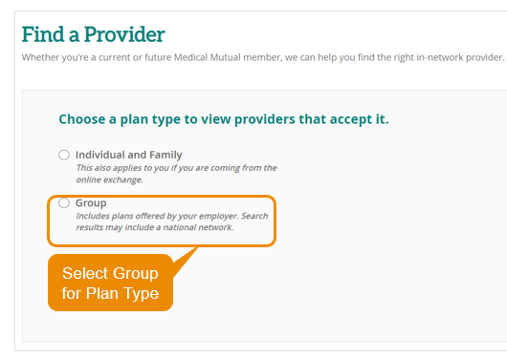
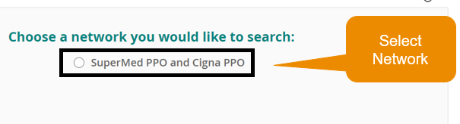
MMO Resources & How to Find a Doctor, Hospital
You have choices when looking for an in-network doctor or hospital before and after you enroll.
24/7 digital access.
Download our mobile app or visit MedMutual.com.
Call the Customer Care team for assistance: 1-800-362-2656
Mon – Thurs: 7:30 AM to 7:30 PM, Fri: 7:30 AM to 6 PM, Sat: 9 AM to 1 PM
Visit MedMutual.com to look up doctors and hospitals.
Email and chat live with a representative.
https://providersearch.medmutual.com/

Slide 16
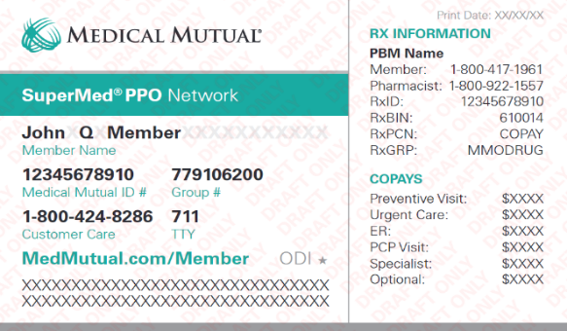
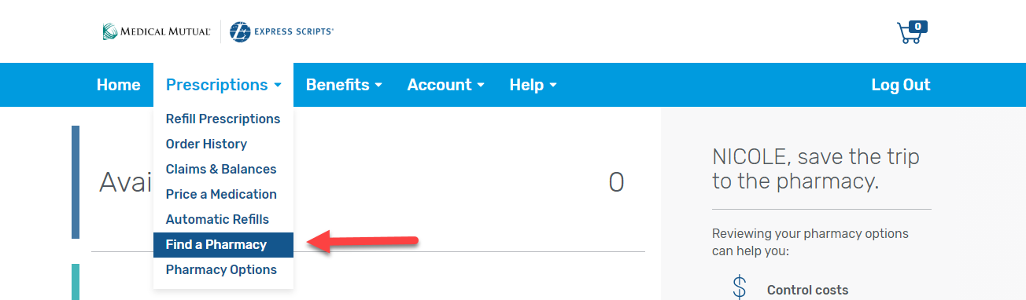
MMO Express Scripts Pharmacy
Call the Rx Information number on your ID card to speak with a representative from Express Scripts, 24 hours a day, 7 days a week to help with any of your prescription drug concerns, including:
Finding an in-network pharmacy
Determining the cost of your medication
Moving your medication to mail order
Checking the status of mail order claims
Any other prescription drug questions you may have
To find a network pharmacy, log in to My Health Plan:
Click on the Benefits & Coverage tab.
Select Prescription Drug Benefits.
Click the Sign on to Express Scripts button.
You will be securely re-directed to the Express Scripts website.
From there, click on Manage Prescriptions, then select Find a Pharmacy.

Slide 17
MMO National Plus Maintenance Pharmacy Network
Medical Mutual’s broadest participating pharmacy network that includes national and regional chain pharmacies.
Over 64,000 pharmacies nationwide.
Includes 90-day maintenance retail option at better discounts than 30-day refill.
Mail order also available through Express Scripts.
Included Major Retail Pharmacies
Kroger CVS Walgreens Giant Eagle Discount Drug Mart | Walmart Meijer Target Marc’s

Slide 18
MMO Specialty Drug Solution
Medical Mutual’s Specialty Drug Solution helps make sure you receive the care you need.
You can fill up to a 30-day supply of a specialty drug at a time.
Specialty pharmacies provide extra care, including:
Dedicated nursing and pharmacy staff who are available 24 hours a day to answer your questions.
Free delivery of supplies, such as syringes.
Injection training, either by phone or in person.
Follow up and assistance with payment plans, if needed.
To get started, just call one of our contracted specialty pharmacies and they will contact your prescriber for the prescription.
Accredo: 1-800-417-1961
Gentry: 1-844-443-6879
University Hospitals of Cleveland Specialty Pharmacy: 1-833-466-0012

Slide 19


APEX MEC Medical/Rx is now The Loomis Company
Notes:
Vinylmax is introducing new for 2024, if we have enough participants, a new low cost/ affordable option for everyday access to healthcare. Through APEX we are introducing a “MEC PLAN” or Minimum Essential Coverage or “skinny plan” as it is sometimes referred to.

Slide 20
What medical plan do I choose?
MEC - Minimum Essential Coverage or “skinny plan”
This is not traditional health insurance. This is separate from MMO plans. Network is with PHCS.
Less expensive weekly premiums but limited protection & is not for everyone.
This plan doesn’t provide coverage for the emergency room, surgeries, or inpatient hospital.
This plan provides coverage at 100% for preventive services
Telehealth & behavioral services are free and unlimited.
Provides 3 primary care visits for $20 per visit. Additional visits charges, your responsibility.
Provides 3 specialty doctor visits for $50 per visit. Additional visits charges, your responsibility.
Provides 3 urgent care visits for $50 per visit. Additional visits charges, your responsibility.
Provides 5 visits to lab/x-ray for $50 per visit. Additional visits charges, your responsibility.
Provides 1 imagining for $200. Additional visits charges, your responsibility.
For more details, including prescription coverages, see plan summary.
Notes:
This Minimum Essential Coverage is not traditional health insurance. This is separate from UHC plans and is not a major medical plan. The Network with this coverage is PHCS.
Here are the highlights: Less expensive weekly premiums but limited protection & is not for everyone. Not for anyone with chronic healthcare needs.
This plan doesn’t provide coverage for the emergency room, surgeries, or inpatient hospital.
This plan provides coverage at 100% for preventive services
Telehealth & behavioral services are free and unlimited.
Provides 3 primary care visits for $20 per visit. Additional visits charges, your responsibility.
Provides 3 specialty doctor visits for $50 per visit. Additional visits charges, your responsibility.
Provides 3 urgent care visits for $50 per visit. Additional visits charges, your responsibility.
Provides 5 visits to lab/x-ray for $50 per visit. Additional visits charges, your responsibility.
Provides 1 imagining for $200. Additional visits charges, your responsibility.
For more details, including prescription coverages, see HR and/or the MEC plan summary.

Slide 21
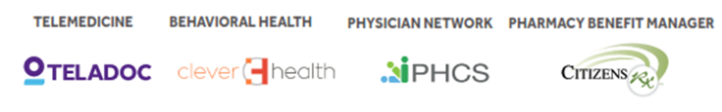
What plan do I choose?
MEC - Minimum Essential Coverage or “skinny plan”
Keep in mind this is not a Major Medical plan, nor priced like a Major Medical plans.
Not intended for people with chronic conditions, or those in need of expensive specialty or maintenance drugs.
Pharmacies included in the network include Costco, CVS, Kroger, Meijer, Rite Aid, Sam’s, Walgreens, Walmart.
Here below, list of partner vendors:
Notes:
When deciding if this is the right plan for you and/or you and your family,
Keep in mind this is not a Major Medical plan, nor priced like a Major Medical plans. Emergency room, surgeries, inpatient, outpatient hospital stays, and specialty medications are not included/not covered at all.
Not intended for people with chronic conditions, or those in need of expensive specialty or maintenance drugs.
Pharmacies included in the network include Costco, CVS, Kroger, Meijer, Rite Aid, Sam’s, Walgreens, Walmart.
The vendors this plan partners with are Teladoc, Cleverhealth, PHCS and CitizensRx

Slide 22
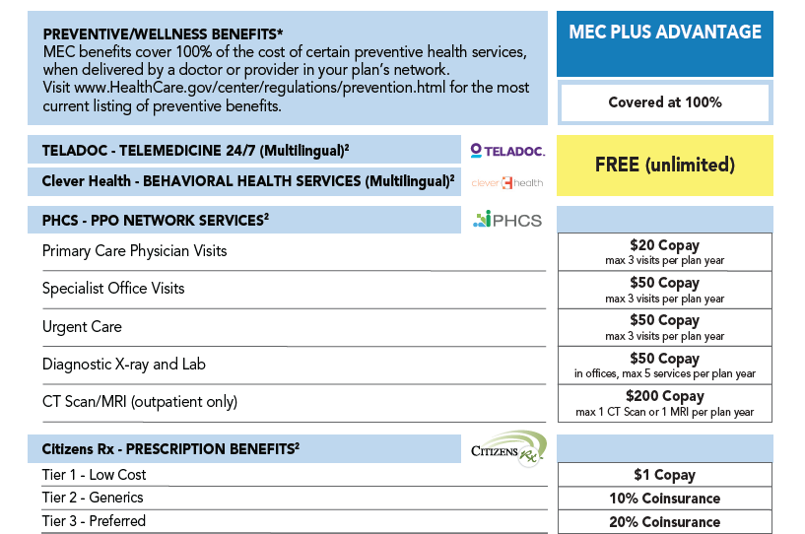
MEC Medical – Highlights
Notes:
Read summary and add…. Keep in mind the MEC Plus Advantage is not Major Medical plans, nor are they priced like Major Medical plans. Let’s review the plan features. Review the benefits on the slide

Slide 23
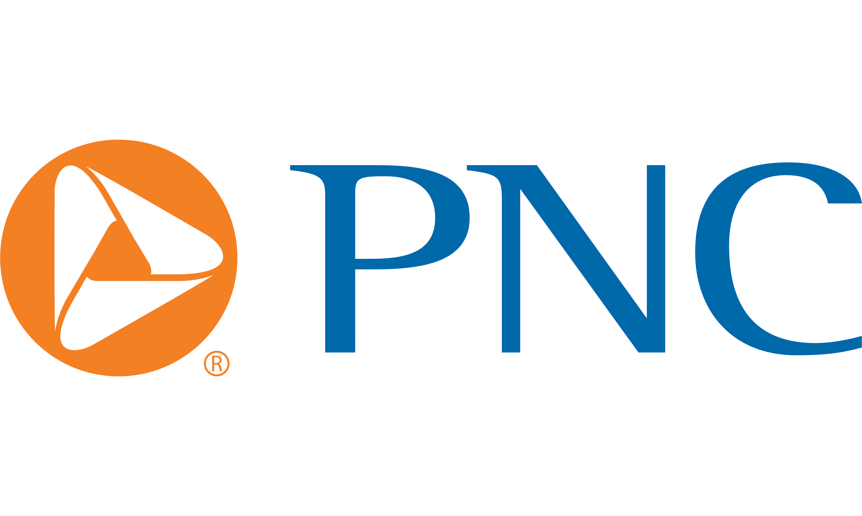
Health Saving Spending Account
Notes:
Vinylmax offers a health spending account through PNC.

Slide 24

Health Savings Account
A Health Savings Account (HSA) is a type of account you can use to set aside money to pay for qualified health care expenses.
This account helps offset your medical costs by giving you tax advantages, allowing your income to stretch farther by using the dollars that would have otherwise been paid in taxes.
You must be eligible for an HSA
You may only spend the dollars on qualified medical expenses and keep itemized receipts
The IRS sets an annual maximum contribution each year. For 2026 the maximum contribution is:
$4,400 for Individuals
$8,750 for Family
Those 55 and older and not enrolled in Medicare can contribute an additional $1,000 “catch up” contribution
Vinylmax Annual HSA Enrollment Contribution | Amount
Employee | $600
Employee & Spouse | $1,000
Employee &Child(ren) | $1,000
Family | $1,000
Notes:
A Health Savings Account (HSA) is a type of account you can use to set aside money to pay for qualified health care expenses.
This account helps offset your medical costs by giving you tax advantages, allowing your income to stretch farther by using the dollars that would have otherwise been paid in taxes.
You must be eligible for an HSA
You may only spend the dollars on qualified medical expenses and keep itemized receipts
The IRS sets an annual maximum contribution each year. For 2023 the maximum contribution is:
$4,150 for Individuals
$8,300 for Family
Those 55 and older and not enrolled in Medicare can contribute an additional $1,000 “catch up” contribution
Vinylmax contributes $600 for employee and $1,000 for employee plus dependents.

Slide 25
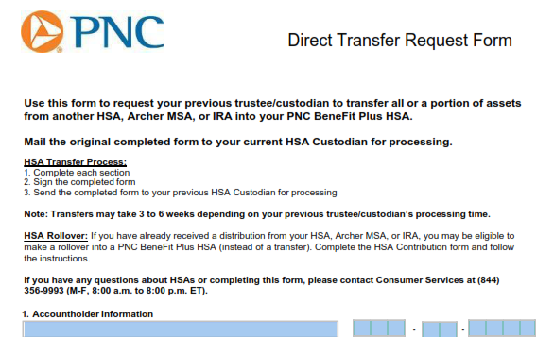

Health Savings Account
All HSA accounts are managed by PNC Bank.
If you currently have an HSA through another bank, you will have to fill out a Direct Transfer Request Form from PNC to request your previous trustee/custodian to transfer all assets from another HSA into your PNC BeneFit Plus Account.
Notes:
A health savings account or HSA is an account you can use to pay for medical expenses. You own this account and take it with you if you would happen to leave Vinylmax. The amounts roll over year after year however you must be eligible to have an HSA and you must spend the money on qualified medical expenses.
All HSA accounts are managed by PNC Bank.
If you currently have an HSA through another bank, you will have to fill out a Direct Transfer Request Form from PNC to request your previous trustee/custodian to transfer all assets from another HSA into your PNC BeneFit Plus Account.

Slide 26

Flexible Spending Account
Notes:
Lets’ take a minute to review the flexible savings account.

Slide 27

Flexible Spending Accounts
Flexible Spending Accounts (FSA) are a great way for you to SAVE MONEY on pre-planned health and day care expenses!
Participation is 100% voluntary
Savings are TAX FREE, not Tax Deferred
Supported by Section 125 and 129 of the IRS Code
2026 Contribution Maximum: $3,400
Decision is IRREVOCABLE for the entire plan year!
Adjustments can be made if a “permitted election change events” (marriage, divorce, death, birth, adoption) occurs
Watch out for the “Use it or Lose it” rule
Notes:
A flexible spending account is a dedicated savings account to help save money for health care costs. You can set aside money on a pre-tax basis for out-of-pocket medical expenses, dental and vision expenses. It is a use it or lose account and 100% of the amount you elected will be available at the beginning of the plan year. Flexible Spending Accounts (FSA) are a great way for you to SAVE MONEY on pre-planned health and day care expenses!
Participation is 100% voluntary
Savings are TAX FREE, not Tax Deferred
Supported by Section 125 and 129 of the IRS Code
2024 Contribution Maximum: $3,200
Decision is IRREVOCABLE for the entire plan year!
Adjustments can be made if a “permitted election change events” (marriage, divorce, death, birth, adoption) occurs

Slide 28

Dependent Care FSA Plan
Dependent care FSA annual max is $7,500. If spouses are filing taxes separately, the limit is $3,750 per spouse.
Plan features include:
Payment for certain IRS-approved dependent daycare expenses with pre-tax dollars.
Rollover provision does not apply. Use it or lose it rule applies.
Eligible for care while parents are at work or school.
ONLY amount payroll deducted to date is available for distribution.
Some examples include:
Daycare/Preschool for dependent children
Adult daycare
Before and after school programs
Camps
Notes:
Dependent care FSA plan allows you to set aside money on a pre-tax basis for daycare/preschool for dependent children to age 13, adult daycare, before and after school program and camps. It is a use it or lose it plan as well and the full amount is not available at the beginning of the plan year.

Slide 29

Dental
Notes:
Let’s review your dental offering

Slide 30


Dental - Highlights
 | Dental PPO
Annual Deductible | $50 per individual $150 per family
Benefit Maximum | $1,500
Deductible Waived for Preventive Care | Yes
Preventive Care | 100%
Basic Services* | 80% after deductible
Major Services* | 50% after deductible
Orthodontia Services | 50% with a lifetime max of $1,500
 | Weekly Contributions
Employee | $3.32
Family | $8.15
Employee Contributions shown, Vinylmax is covering 50% of the cost.
Notes:
Next, take a moment to review the vision plan benefits. There are no plan changes for the vision coverage for 2024. Remember, if you use an in-network provide you will not be balance billed. Weekly Employee Contributions shown with Vinylmax covering 50% of the cost.

Slide 31

Vision
Notes:
Next, we’ll look at the vision offering.

Slide 32


Vision – Highlights
 | Vision Plan
Exam Copay | $10 copay
Material Copay | $25 copay
Benefits & Frequency
Exam | Covered every 12 months
Lenses | $25 copay every 12 months
Frames | $130 allowance, 20% of balance, every 24 months
Elective Contacts (in lieu of lenses) | $130 allowance, 15% of balance, every 12 months
 | Weekly Contributions
Employee | $1.49
Employee & Spouse | $2.83
Employee &Child(ren) | $2.98
Family | $4.38
Notes:
Next, we’ll look at the vision. There are no plan changes for the vision coverage for 2024. Remember, if you use an in-network provide you will not be balance billed. Weekly contributions for 2024 are listed here.

Slide 33
Ancillary Coverages
Notes:
Let’s review your ancillary coverages

Slide 34


Basic Life/AD&D
Vinylmax Windows is pleased to provide an employer paid life and accidental death & dismemberment (AD&D) benefit to all eligible employees:
Employee Benefit
$25,000 Life Insurance
$25,000 Guarantee Issue Amount
$25,000 is the Maximum Benefit Amount
Please be sure to review and update your beneficiary information as needed; does not have to be done during Open Enrollment.
Notes:
Vinylmax windows is pleased to provide an employer paid life and accident death and dismemberment also known as AD&D benefit to all eligible employees.
The life insurance amount is $25,000 with a guaranteed issue of $25,000
Please be sure to review and update your beneficiary information as needed. This does not have to be done during Open Enrollment

Slide 35


Voluntary Life AD&D Insurance
Lincoln Financial Group Group Voluntary Life & ADD
Employee
Benefit amount | Increments of $10,000
Benefit Maximum | $500,000
Guaranteed Issue | $200,000
Spouse
Benefit amount | Increments of $5,000
Benefit Maximum | $100,000
Guaranteed Issue | $30,000
Child(ren)
Option 1 | $100- 14 days to 6 months $10,000- age 6 months to 26 years
Option 2 | $100- age 14 days to 6 months $20,000- age 6 months to 26 years
EOI (Evidence of Insurability) form is required if:
You and/or spouse is requesting an amount more than the Guarantee Issue maximum at initial enrollment
You and/or spouse is increasing the current level of coverage by more than 2 increments
You and/or spouse previously declined coverage and are electing coverage this year
Notes:
You have the option to elect additional life insurance on yourself and your dependents. If you have already elected coverage and want to increase coverage on yourself or your spouse, if you request amounts above the guarantee issue you will need to provide medical information for approval.

Slide 36

Disability Insurance
Disability insurance protects your paycheck if you are unable to work due to a qualifying disability (accident or sickness).
Simply put, a short-term disability is an instance that puts you out of work temporarily, such as an injury, illness or procedure. When one of these incidents happens and you cannot earn an income, you may be able to qualify for benefits if you are enrolled in a short-term disability insurance plan of time.
Long-term disability insurance provides income to those whose earnings are interrupted by lengthy periods of disability
Notes:
Read slide

Slide 37


Core Short Term Disability
The following highlights details regarding our employer paid short-term disability plan.
This plan is 100% covered by Vinlymax for Full-Time eligible employees. If you would like to purchase additional short-term disability coverage, there is a buy-up option on the next slide.
 | STD Core Plan
Elimination Period
Accident | 7 days
Sickness | 7 days
Benefit Percentage | 50%
Weekly Benefit Maximum | $170
Maximum Benefit Period | 13 weeks
Pre-Existing Condition Limitations | None
Notes:
For Full time employees short term disability will pay after 7 days for an accident or sickness up to 13 weeks of continued disability. You will receive 50% of your weekly pay to a weekly maximum of $170

Slide 38

Voluntary Buy-Up Short Term Disability
The following highlights details regarding our employee paid short-term disability plan.
This plan is 100% paid for by the employee, if you would like to purchase additional short-term disability coverage.
 | STD Buy-up Plan
Elimination Period
Accident | 7 days
Sickness | 7 days
Benefit Percentage | 60%
Weekly Benefit Maximum | $500
Maximum Benefit Period | 13 weeks
Pre-Existing Condition Limitations | None
Notes:
This plan is 100% paid for by the employee, if you would like to purchase additional short-term disability coverage. This plan offers the weekly benefit maximum of $500

Slide 39


Long-Term Disability
The following highlights details regarding our long-term disability plan.
100% paid by employees if you wish to purchase long-term disability coverage
Offered to salaried employees at no cost
 | Long-Term Disability
Elimination Period | 90 days
LTD Benefit | 60% up to a monthly maximum of $5,000
Definition of Disability | 2-year own occupation
Maximum Disability Period | Social Security Normal Retirement Age
Pre-Existing Condition Limitations | 12 months for conditions treated within the 3 months prior to effective date of coverage
Notes:
Long-term disability benefits continue after the short-term period has fun out and you are still on disability. After the 90-day elimination period, if continually disabled it can pay to your social security normal retirement age. You will receive 60% of your monthly pay to a maximum of $5,000.

Slide 40


Voluntary Accident Insurance
Accident insurance is a form of insurance policy that offers a payout if you experience an injury outside of work.
You have a choice of two plans: Low Plan and High Plan.
Coverage is guaranteed for you and your family.
Payments are made directly to you to spend as you choose.
100% paid by employees, if you want to purchase voluntary accident insurance.
Notes:
Voluntary Accident insurance is a form of insurance policy that offers a payout if you experience an injury outside of work.
You have a choice of two plans: Low Plan and High Plan.
Coverage is guaranteed for you and your family.
Payments are made directly to you to spend as you choose.

Slide 41

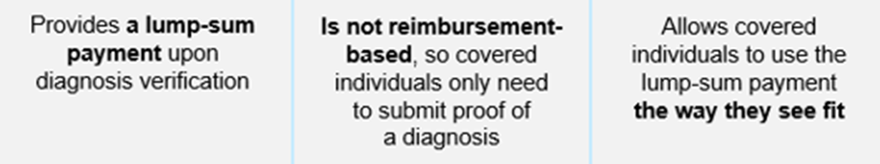

Voluntary Critical Illness
Critical Illness Insurance provides benefits when a covered person is diagnosed with an eligible condition or illness. It helps offset expenses not reimbursed by other types of insurance.
It is not a replacement for traditional medical or disability income insurance. Rather it is a compliment to these other coverages.
Your critical illness insurance enrollment is guaranteed provided you are actively at work.
100% paid by employees, if you want to purchase voluntary critical illness insurance
Notes:
Critical Illness Insurance provides benefits when a covered person is diagnosed with an eligible condition or illness. It helps offset expenses not reimbursed by other types of insurance.
It is not a replacement for traditional medical or disability income insurance. Rather it is a compliment to these other coverages.
Your critical illness insurance enrollment is guaranteed provided you are actively at work. This coverage is 100% paid by employees, if you want to purchase voluntary critical illness insurance

Slide 42


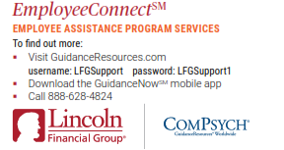
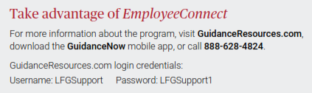
Employee Assistance Program – EAP
EmployeeConnect offers professional, confidential services to help you, and your loved ones improve your quality of life.
Receive confidential help 24 hours a day, seven days a week for employees and their family members. Get help with:
Family
Parenting
Addictions
Emotional
Legal
Financial
Relationships
Stress
Notes:
Employee Connect offers professional, confidential services to help you and your loved ones improve your quality of life for anyone with Lincoln coverage.
Receive confidential help 24 hours a day, seven days a week for employees and their family members.
Get help with:
-family
-parenting
-addictions
-emotional help
-legal
-financial troubles
-relationships
And stress
For more information about the program, please visit guidanceresources.com, download the guidance now mobile app, or call 888-628-4824

Slide 43


2026 Enrollment Process
Notes:
Let’s review the 2024 open enrollment process

Slide 44

2026 Enrollment Process
This open enrollment is passive meaning your current enrollment selections will roll over to 2026. If you’d like to make any changes, you need to go online through Employee Navigator to make those selections/changes.
New ID cards will be sent home only if you are a new enrollee.
No benefit enrollments or changes are accepted after the open enrollment period unless due to a family status change (qualifying event).
Notes:
This open enrollment is passive meaning your current enrollment selections will roll over to 2024. If you’d like to make any changes, you need to go online through Employee Navigator to make those selections/changes.
New ID cards will be sent home only if you are a new enrollee.
To enroll and/or learn more about the NEW MEC Advantage Plus option, please see HR for the application and details.
No benefit enrollments or changes are accepted after the open enrollment period unless due to a family status change (qualifying event).

Slide 45
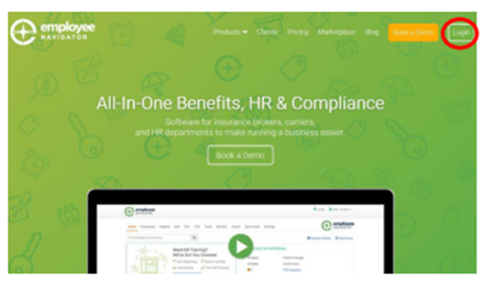


2026 Enrollment Process For anyone new or making changes Log at www.employeenavigator.com You can also access Employee Navigator directly through your Paycor account using the single sign-on feature.
Notes:
2024 Enrollment Process For anyone new or making changes Log at www.employeenavigator.com
Click on the “Login” button to get started.
If you have already registered & have your username & password, enter them to log in.
If you forgot your password, you can request to reset it.
If this is your first time, you can find an invite email sent for new hires or select “Register as a New User”
Your first name and last name must match your employee file.
The company identifier is Vinylmax
PIN is the last 4 digits of your social security number
Enter your birth date in mm/dd/yyyy format
Click Next to register

Slide 46

Mid-Year Plan Changes
You are only able to add or drop coverage during the plan year if you have a federal qualified event such as:
Change in marital status
Change in number of dependents
Change in employment status
Change in eligibility status
Any changes made must be consistent and correspond with the change in status.
Documentation is required for any mid-year status changes.
If you are making a mid-year plan change you must notify HR within 30 days of the qualifying event.
Notes:
You are only able to add or drop coverage during the plan year if you have a federal qualified event such as:
Change in marital status
Change in number of dependents
Change in employment status
Change in eligibility status
Any changes made must be consistent and correspond with the change in status.
Documentation is required for any mid-year status changes.
If you are making a mid-year plan change you must notify HR within 30 days of the qualifying event.

Slide 47

Benefit Resource Center
Notes:
If you have any questions on your benefits, feel free to reach out to our benefits resource center by email at brcmidwest@usi.com or call them at 1-855-874-0829. They are available Monday through Friday 8:00 am to 5:00 pm.

Slide 48


Thank You!
All open enrollment election changes are due by: Nov 18th , 2025
Notes:
Thank you for listening to this this presentation, make sure your elections are submitted by November 28th. Thank you.

