Slide 1

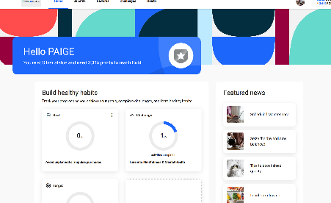
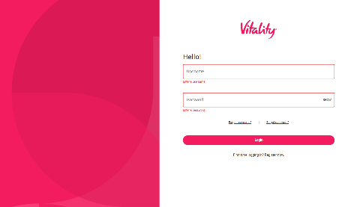
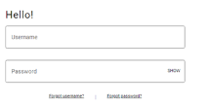
Employee Experience
Enhanced WorkSpring Wellness Portal
WorkSpring Wellness is a program that offers tools and resources to help you live a longer, healthier life.
Earn points
Engage in healthy activities like walking, getting enough sleep, visiting the doctor, and setting achievable goals.
Achieve a status
Each year, the number of Points you accumulate will determine your Status (Bronze, Silver, Gold, or Platinum).
Points & Status
0
2,500
6,000
10,000
Get rewarded
The more you participate, the more points you earn; the higher your status, the greater your rewards.
Notes:
Starting in January 2026, all our WorkSpring Members will now be on our new Vitality Platform.
This new innovative platform will offer a variety of resources, tools, and activities to help you live a healthier life.
Easily Earn Points:
Sync a Fitness Device or download our MedMutual Well App to easily track and earn points for activities like walking, getting plenty of sleep, getting your preventative visits, and setting achievable goals that are priorities to you.
Achieve a Status:
The Number of Points you accumulate will determine your status.
Hit the platinum level to be entered into more incentive opportunities.
Get Rewarded:
The more you participate in the portal, the more points you can earn. Giving you more opportunities for squares and rewards.

Slide 2

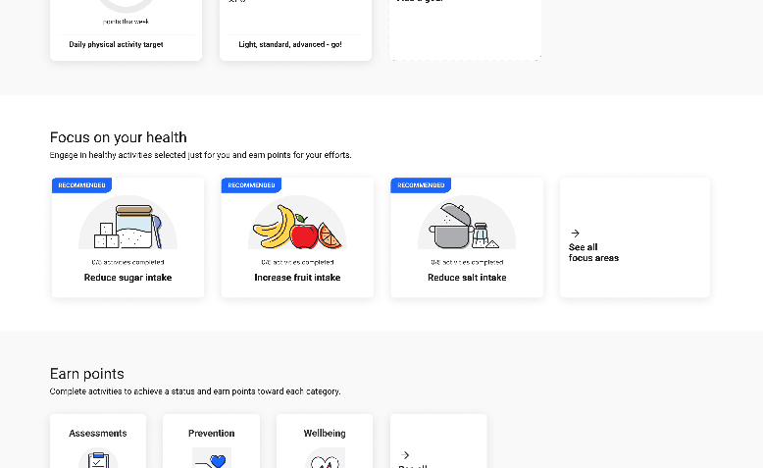
Wellness Portal: Hyper-Personalization
Employee Experience
Hyper-personalization allows you to determine your own focus areas and goals
Complete a variety of Health Assessments
Track participation and earn points
Schedule onsite screening appointments
Sync a fitness device to track steps and activity minutes
Participate in group challenges
Access Medical Mutual resources and services
Notes:
The program is personalized using your responses from your onboarding and health assessments. We recommend focus areas relevant to you and your areas of interests.
Everyone's portal will have different recommended areas of focus. You can also decide which healthy habits you want to build. Then by completing these habits, you can earn points and monitor where you are with your goals.

Slide 3
