Slide 1
2025 Benefits Presentation
CONFIDENTIAL AND PROPRIETARY: This presentation and the information contained herein is confidential and proprietary information of USI Insurance Services, LLC ("USI"). Recipient agrees not to copy, reproduce or distribute this document, in whole or in part, without the prior written consent of USI. Estimates are illustrative given data limitation, may not be cumulative and are subject to change based on carrier underwriting. © 2018 USI Insurance Services. All rights reserved.
Notes:
Welcome to the 2024 Open Enrollment Presentation

Slide 2
Open Enrollment for New Hires
Per IRS rules:
This is your opportunity to make changes to your benefit elections and to review which dependents you will cover.
Elections made during this period will remain in effect for 2025, unless you experience an IRS-approved “qualifying event”
Approved qualifying events include:
Marriage or Divorce
Death
Birth or adoption of a dependent
Change in employment status
Change in dependent’s eligibility status
Loss of or significant change to your current coverage
Judgment, decree or court order
Elections will remain effective for all of 2024. You have 30 days from the date of the qualifying event to notify HR and make changes.
Notes:
Open enrollment is the time to elect and/or make changes to your benefits as well as make sure your dependents are still eligible for benefits. You cannot make any changes until the next open enrollment period unless you experience an approved qualifying event. You have 30 days to contact human resources to notify human resources.

Slide 3
Who is Eligible?
Full-Time employee working at least 30 hours per week
Employees eligible at 30 days of employment
Spouses
Court Decree Spouse
Dependents:
Unmarried & married child(ren) to age 26
Full-Time Student to age 26
Court Decree Dependent
Notes:
read

Slide 4
UHC Medical/Rx
Notes:
Medical benefits are through United Healthcare.

Slide 5
UHC Medical Highlights
 | HDHP HSA | PPO
Annual Deductible | $5,000 per individual $10,000 per family | $4,000 per individual $8,000 per family
Annual Out-of-Pocket Maximum** | $6,750 per individual $13,500 per family | $7,900 per individual $15,800 per family
Plan Coinsurance | 80% in most cases | 70% in most cases
Primary Office Visit | DN: Deductible then 80% N: Deductible then 60% | $40 copay
Specialty Office Visit | DN: Deductible then 80% N: Deductible then 60% | DN: $60 copay / N: $100 copay
Lab & X-ray | Deductible then 80% | DN: Deductible then 70% N: Deductible then 50%
Complex Radiology | Deductible then 80% | 70% after deductible
Inpatient Hospital | Deductible then 80% | 70% after deductible
Emergency Room | Deductible then 80% | $300 copay then 70% after deductible
*The deductible is calculated on an embedded basis.
**The out-of-pocket maximum includes the deductible all eligible copays and coinsurance amounts.
Notes:
You have two medical plan options through UHC. A High Deductible Health Plan or HDHP and a PPO plan. The PPO plan is a copay plan and the HDHP plan has no copays, once the deductible is satisfied the coinsurance will kick in. Let’s review your plan benefits…. On the HDHP H.S.A. plan the individual deducible is $5,000 and the family is $10,000. The plan coinsurance is 80% and the plan member is responsible for deductible then 20% of the cost up to the annual max out of pocket of $6,750 for an individual and $13,500 for a family.
On the PPO plan the annual deductible is $4,000 for an individual and $8,000 for a family for services subject to the deductible. Office visit and specialty visits just require the applicable copay depending on if the provider is in the designated network or a regular network provider.

Slide 6
Medical – HDHP HSA Features
Continuing for 2025 for the HDHP HSA Plan:
Vinylmax HSA contribution of $600 for an employee covered on the HDHP HSA plan and $1,000 for those with employee/spouse, employee/child, or family coverage.
Annual contributions are evenly distributed based on the employee’s pay frequency.
HSA contributions can be set-up on payroll and will automatically be set up through PNC Bank.
NOTE: Please refer to your vendor benefit summaries for a detailed listing of covered benefits. Benefits listed in this presentation are for illustrative purposes only.
Notes:
For Those enrolled in the HDHP plan, the Vinylmax HSA contribution for an employee covered on the HDHP HSA plan is $600 and $1,000 for those with employee/spouse, employee/child, or family coverage.
Annual contributions are evenly distributed based on the employee’s pay frequency.
HSA contributions can be set-up on payroll and will automatically be set up through PNC Bank.

Slide 7
UHC Rx – Plan Highlights
 | HDHP HSA | PPO
Rx Deductible | Rx subject to medical deductible | N/A
Retail Prescription Drugs
Generic | Deductible then $5 copay | $10 copay
Preferred Brand Name | Deductible then $40 copay | $65 copay
Non-Preferred Brand Name | Deductible then $105 copay | $125 copay
Preferred Specialty | Deductible then $250 copay | $250 copay
Mail-Order Prescriptions
Generic | Deductible then $12.50 copay | $25 copay
Preferred Brand Name | Deductible then $100.00 copay | $162.50 copay
Non-Preferred Brand Name | Deductible then $262.50 copay | $312.50 copay
Preferred Specialty | Deductible then $625 | $625 copay
Notes:
Your prescription coverage on the HDHP H.S.A. plan you must satisfy the deductible, then the applicable copay applies. Please take moment to review. One the PPO plan for generic you have $10 copy, preferred brand name $65 copay , preferred brand name $125 copay and preferred specialty $250 copay. Mail order is a convenient way to your prescriptions mailed directly to you home.

Slide 8
What medical plan do I choose?
PPO Plan: Traditional Preferred Provider Organization Plan.
Compared to an HSA plan, this one has higher paycheck cost, lower deductible, higher out of pocket max.
Copayments (with no deductible) apply to office visits, prescriptions
All copayments apply to the out-of-pocket max.
This plan is good for those with steady, predictable medical expenses with lower out of pocket immediate risk exposure. (You're willing to pay higher premiums than the HSA in exchange for the certainty of lower out-of-pocket costs related to specific medical needs.)
Notes:
What medical plan do I choose? Looking at the PPO plan option here are some considerations. Compared to an HSA plan, the PPO plan has higher paycheck cost, lower deductible, higher out of pocket maximum.
On the PPO Copayments apply to office visits, prescriptions and not subject to the deductible)
All copayments & coinsurance apply to the out-of-pocket max.
The PPO plan is good for those with steady, predictable medical expenses with lower out of pocket immediate risk exposure. (You're willing to pay higher premiums than the HSA in exchange for the certainty of lower out-of-pocket costs related to specific medical needs.)

Slide 9
What medical plan do I choose?
HDHP HSA Plan (High deductible Plan)
Compared to a PPO plan, this plan has a lower paycheck cost, higher deductible, lower out of pocket max.
Must pay the entire services and meet the deductible before insurance coverage begins (excluding preventive visits).
Can establish a health savings account (HSA) to cover current & future health expenses.
This plan is good for those who want to pay less with each paycheck and want the company contribution to the HSA but has readily available funds to pay for all health care costs before the deductible is met.
Notes:
What medical plan do I choose? Looking at the HDHP HSA plan option here are some considerations. Compared to a PPO plan, the HDHP plan has a lower paycheck cost, higher deductible, lower out of pocket max.
Keep in mind you Must pay the entire services and meet the deductible before insurance coverage begins (excluding preventive visits).
HDHP plan allows the options to establish a health savings account (HSA) to cover current & future health expenses.
This plan is good for those who want to pay less with each paycheck and want the company contribution to the HSA but has readily available funds to pay for all health care costs before the deductible is met.

Slide 10
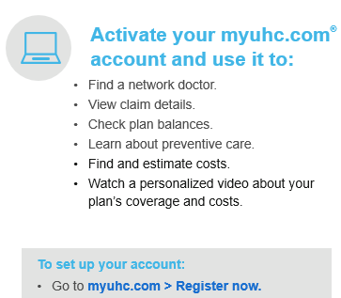
UHC Medical – Highlights
Preventive care– covered at 100% on all UHC medical plan options
Stay in network – sign into myuhc.com > Find Care and Costs
UHC virtual visits – for nonemergency issues at myuhc.com/virtual visits
Notes:
All Plans cover Preventive care at 100%. Please review and know which services are covered at 100% before your appt. Stay in network to receive the most out of your benefits (lower cost & better healthcare outcomes. To find a provider – sign in to myuhc.com > Find Care and Costs. You can also down the united healthcare mobile app for easy access to your plan resources.
UHC virtual visits are available for nonemergency issues at myuhc.com/virtual visits.

Slide 11
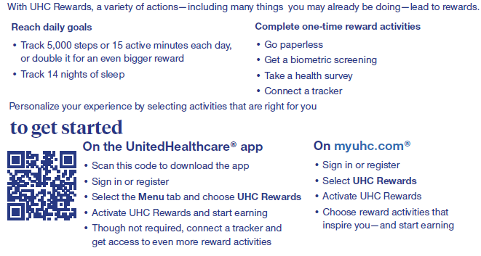
Wellness – UHC Rewards up to $300
Available to employees & spouses enrolled in a UHC plan
Notes:
Wellness – UHC Rewards up to $300! These rewards are Available to employees & spouses enrolled in a UHC plan. With UHC rewards a Varity of activities are available to earn your rewards. To get started scan the QR code or log on myuhc.com, or download the app.

Slide 12
Wellness – One Pass Select
Notes:
Wellness – UHC Rewards up to $300! These rewards are Available to employees & spouses enrolled in a UHC plan. With UHC rewards a Varity of activities are available to earn your rewards. To get started scan the QR code or log on myuhc.com, or download the app.

Slide 13
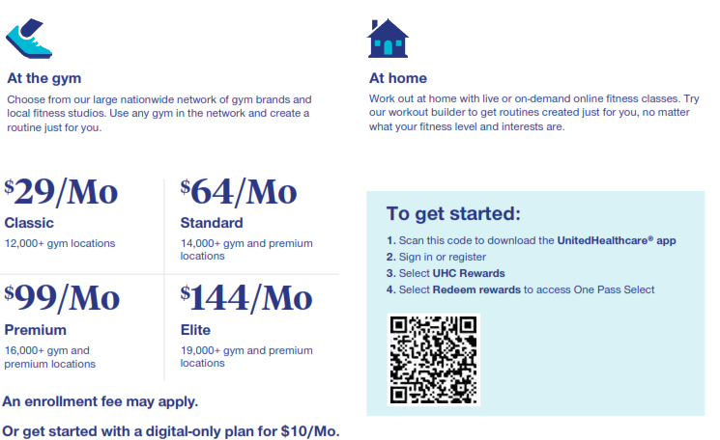
Wellness – One Pass Select
Notes:
Wellness – UHC Rewards up to $300! These rewards are Available to employees & spouses enrolled in a UHC plan. With UHC rewards a Varity of activities are available to earn your rewards. To get started scan the QR code or log on myuhc.com, or download the app.

Slide 14
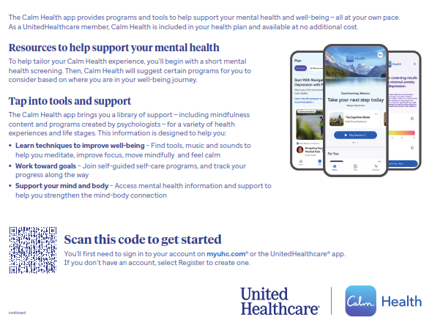
Wellness – Calm Health
Notes:
Wellness – UHC Rewards up to $300! These rewards are Available to employees & spouses enrolled in a UHC plan. With UHC rewards a Varity of activities are available to earn your rewards. To get started scan the QR code or log on myuhc.com, or download the app.

Slide 15
APEX MEC Medical/Rx is now The Loomis Company
Notes:
Vinylmax is introducing new for 2024, if we have enough participants, a new low cost/ affordable option for everyday access to healthcare. Through APEX we are introducing a “MEC PLAN” or Minimum Essential Coverage or “skinny plan” as it is sometimes referred to.

Slide 16
What medical plan do I choose?
MEC - Minimum Essential Coverage or “skinny plan”
This is not traditional health insurance. This is separate from UHC plans. Network is with PHCS.
Less expensive weekly premiums but limited protection & is not for everyone.
This plan doesn’t provide coverage for the emergency room, surgeries, or inpatient hospital.
This plan provides coverage at 100% for preventive services
Telehealth & behavioral services are free and unlimited.
Provides 3 primary care visits for $20 per visit. Additional visits charges, your responsibility.
Provides 3 specialty doctor visits for $50 per visit. Additional visits charges, your responsibility.
Provides 3 urgent care visits for $50 per visit. Additional visits charges, your responsibility.
Provides 5 visits to lab/x-ray for $50 per visit. Additional visits charges, your responsibility.
Provides 1 imagining for $200. Additional visits charges, your responsibility.
For more details, including prescription coverages, see plan summary.
Notes:
This Minimum Essential Coverage is not traditional health insurance. This is separate from UHC plans and is not a major medical plan. The Network with this coverage is PHCS.
Here are the highlights: Less expensive weekly premiums but limited protection & is not for everyone. Not for anyone with chronic healthcare needs.
This plan doesn’t provide coverage for the emergency room, surgeries, or inpatient hospital.
This plan provides coverage at 100% for preventive services
Telehealth & behavioral services are free and unlimited.
Provides 3 primary care visits for $20 per visit. Additional visits charges, your responsibility.
Provides 3 specialty doctor visits for $50 per visit. Additional visits charges, your responsibility.
Provides 3 urgent care visits for $50 per visit. Additional visits charges, your responsibility.
Provides 5 visits to lab/x-ray for $50 per visit. Additional visits charges, your responsibility.
Provides 1 imagining for $200. Additional visits charges, your responsibility.
For more details, including prescription coverages, see HR and/or the MEC plan summary.

Slide 17
What plan do I choose?
MEC - Minimum Essential Coverage or “skinny plan”
Keep in mind this is not a Major Medical plan, nor priced like a Major Medical plans.
Not intended for people with chronic conditions, or those in need of expensive specialty or maintenance drugs.
Pharmacies included in the network include Costco, CVS, Kroger, Meijer, Rite Aid, Sam’s, Walgreens, Walmart.
Here below, list of partner vendors:
Notes:
When deciding if this is the right plan for you and/or you and your family,
Keep in mind this is not a Major Medical plan, nor priced like a Major Medical plans. Emergency room, surgeries, inpatient, outpatient hospital stays, and specialty medications are not included/not covered at all.
Not intended for people with chronic conditions, or those in need of expensive specialty or maintenance drugs.
Pharmacies included in the network include Costco, CVS, Kroger, Meijer, Rite Aid, Sam’s, Walgreens, Walmart.
The vendors this plan partners with are Teladoc, Cleverhealth, PHCS and CitizensRx

Slide 18
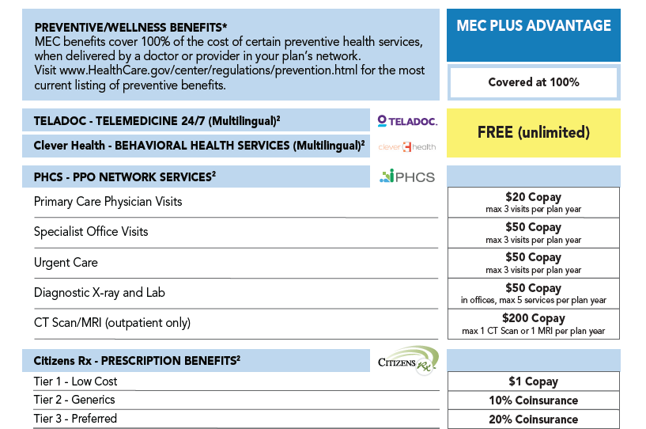
MEC Medical – Highlights
Notes:
Read summary and add…. Keep in mind the MEC Plus Advantage is not Major Medical plans, nor are they priced like Major Medical plans. Let’s review the plan features. Review the benefits on the slide

Slide 19
Medical – Weekly Employee Contributions
Tier/Plan | Preferred Provider Organization PPO Plan |  | High Deductible Health Plan HDHP HSA Plan |  | MEC
Coverrage | Non-Tobacco User | Tobacco User | Non-Tobacco User | Tobacco User | Non-Tobacco User | Tobacco User
Employee | $58.34 | $68.34 | $53.77 | $63.77 | $10.83 | $20.83
Employee & Spouse | $128.22 | $138.22 | $118.19 | $128.19 | $21.88 | $31.88
Employee & Child(ren) | $98.47 | $108.47 | $90.76 | $100.76 | $21.88 | $31.88
Family | $180.08 | $190.08 | $165.99 | $175.99 | $32.37 | $42.37
Payroll deductions are on a weekly pre-tax basis*
Employee contributions shown above, Vinylmax is covering 65% of the cost.
Note: There is a $20/week spousal surcharge .
Notes:
Please take a moment to review the weekly employee contributions for nontobacco user or Tobacco user for the PPO plan, HDHP H.S.A plan and the potential new offering MEC plan. Vinylmax is covering 65% of the plan cost.
Note: There is a $20/week spousal surcharge if applicable.

Slide 20
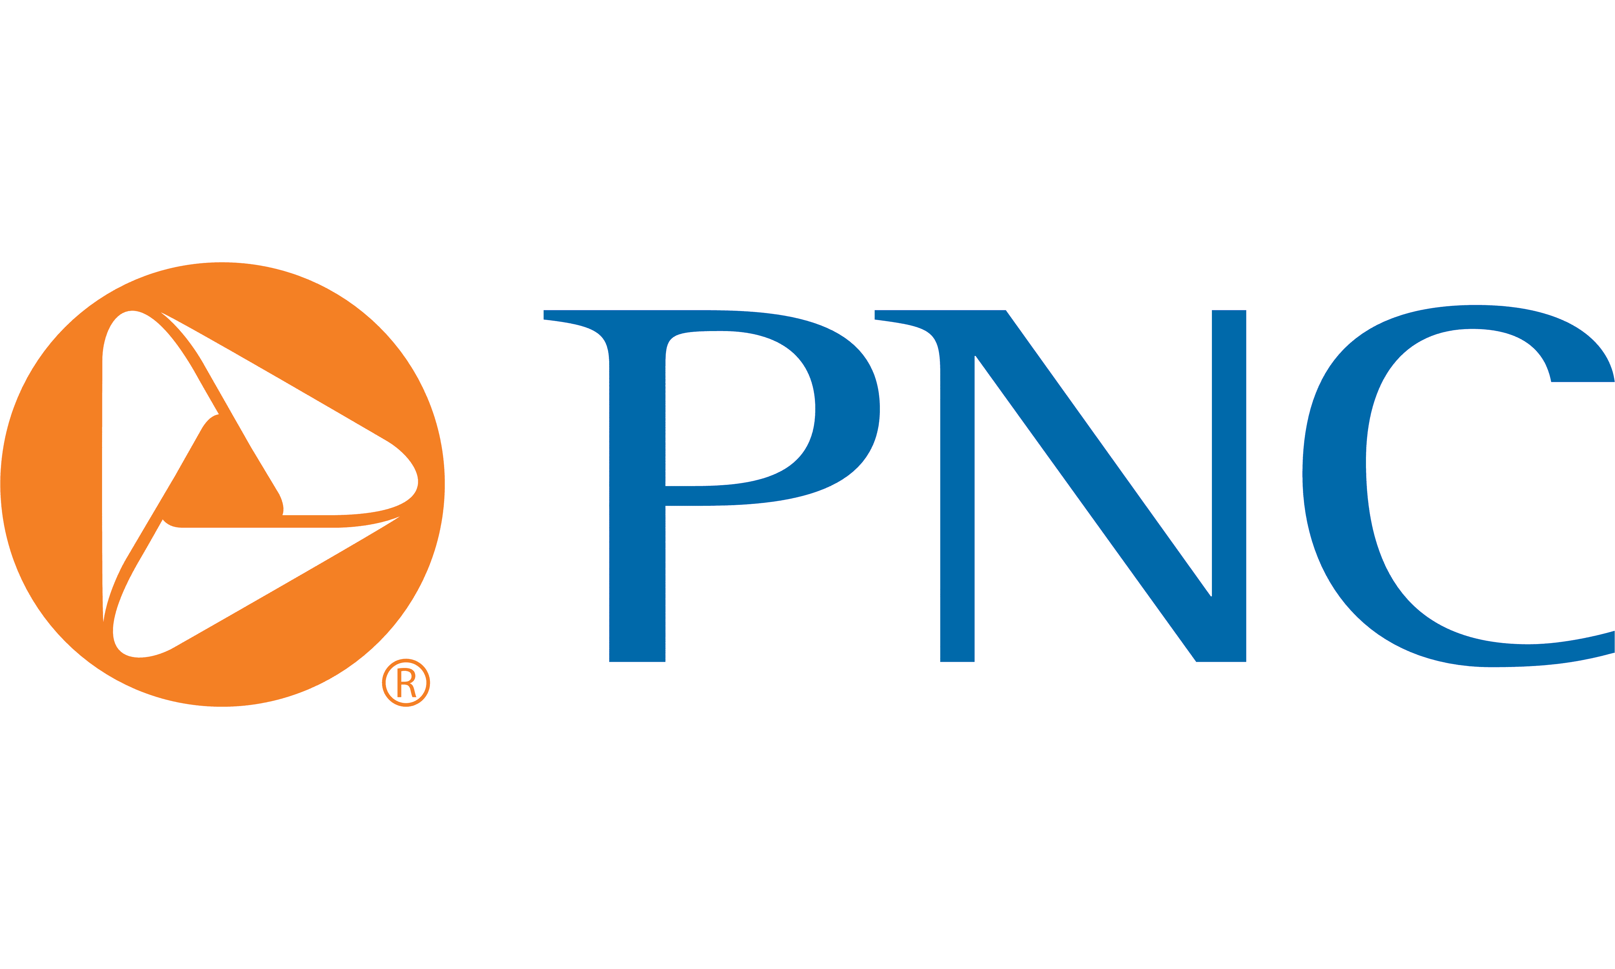
Health Saving Spending Account
Notes:
Vinylmax offers a health spending account through PNC.

Slide 21
Health Savings Account
A Health Savings Account (HSA) is a type of account you can use to set aside money to pay for qualified health care expenses.
This account helps offset your medical costs by giving you tax advantages, allowing your income to stretch farther by using the dollars that would have otherwise been paid in taxes.
You must be eligible for an HSA
You may only spend the dollars on qualified medical expenses and keep itemized receipts
The IRS sets an annual maximum contribution each year. For 2025 the maximum contribution is:
$4,300 for Individuals
$8,550 for Family
Those 55 and older and not enrolled in Medicare can contribute an additional $1,000 “catch up” contribution
Vinylmax Annual HSA Enrollment Contribution | Amount
Employee | $600
Employee & Spouse | $1,000
Employee &Child(ren) | $1,000
Family | $1,000
Notes:
A Health Savings Account (HSA) is a type of account you can use to set aside money to pay for qualified health care expenses.
This account helps offset your medical costs by giving you tax advantages, allowing your income to stretch farther by using the dollars that would have otherwise been paid in taxes.
You must be eligible for an HSA
You may only spend the dollars on qualified medical expenses and keep itemized receipts
The IRS sets an annual maximum contribution each year. For 2023 the maximum contribution is:
$4,150 for Individuals
$8,300 for Family
Those 55 and older and not enrolled in Medicare can contribute an additional $1,000 “catch up” contribution
Vinylmax contributes $600 for employee and $1,000 for employee plus dependents.

Slide 22
Health Savings Account
All HSA accounts are managed by PNC Bank.
If you currently have an HSA through another bank, you will have to fill out a Direct Transfer Request Form from PNC to request your previous trustee/custodian to transfer all assets from another HSA into your PNC BeneFit Plus Account.
Notes:
A health savings account or HSA is an account you can use to pay for medical expenses. You own this account and take it with you if you would happen to leave Vinylmax. The amounts roll over year after year however you must be eligible to have an HSA and you must spend the money on qualified medical expenses.
All HSA accounts are managed by PNC Bank.
If you currently have an HSA through another bank, you will have to fill out a Direct Transfer Request Form from PNC to request your previous trustee/custodian to transfer all assets from another HSA into your PNC BeneFit Plus Account.

Slide 23
Flexible Spending Account
Notes:
Lets’ take a minute to review the flexible savings account.

Slide 24
Flexible Spending Accounts
Flexible Spending Accounts (FSA) are a great way for you to SAVE MONEY on pre-planned health and day care expenses!
Participation is 100% voluntary
Savings are TAX FREE, not Tax Deferred
Supported by Section 125 and 129 of the IRS Code
2025 Contribution Maximum: $3,300
Decision is IRREVOCABLE for the entire plan year!
Adjustments can be made if a “permitted election change events” (marriage, divorce, death, birth, adoption) occurs
Watch out for the “Use it or Lose it” rule
Notes:
A flexible spending account is a dedicated savings account to help save money for health care costs. You can set aside money on a pre-tax basis for out-of-pocket medical expenses, dental and vision expenses. It is a use it or lose account and 100% of the amount you elected will be available at the beginning of the plan year. Flexible Spending Accounts (FSA) are a great way for you to SAVE MONEY on pre-planned health and day care expenses!
Participation is 100% voluntary
Savings are TAX FREE, not Tax Deferred
Supported by Section 125 and 129 of the IRS Code
2024 Contribution Maximum: $3,200
Decision is IRREVOCABLE for the entire plan year!
Adjustments can be made if a “permitted election change events” (marriage, divorce, death, birth, adoption) occurs

Slide 25
Dependent Care FSA Plan
Dependent care FSA annual max is $5,000. Plan features include:
Payment for certain IRS-approved dependent daycare expenses with pre-tax dollars.
Rollover provision does not apply. Use it or lose it rule applies.
Eligible for care while parents are at work or school.
ONLY amount payroll deducted to date is available for distribution.
Some examples include:
Daycare/Preschool for dependent children
Adult daycare
Before and after school programs
Camps
Notes:
Dependent care FSA plan allows you to set aside money on a pre-tax basis for daycare/preschool for dependent children to age 13, adult daycare, before and after school program and camps. It is a use it or lose it plan as well and the full amount is not available at the beginning of the plan year.

Slide 26
Dental
Notes:
Let’s review your dental offering

Slide 27
Dental - Highlights
 | Dental PPO
Annual Deductible | $50 per individual $150 per family
Benefit Maximum | $1,500
Deductible Waived for Preventive Care | Yes
Preventive Care | 100%
Basic Services* | 80% after deductible
Major Services* | 50% after deductible
Orthodontia Services | 50% with a lifetime max of $1,500
 | Weekly Contributions
Employee | $3.19
Family | $7.83
Employee Contributions shown, Vinylmax is covering 50% of the cost.
Notes:
Next, take a moment to review the vision plan benefits. There are no plan changes for the vision coverage for 2024. Remember, if you use an in-network provide you will not be balance billed. Weekly Employee Contributions shown with Vinylmax covering 50% of the cost.

Slide 28
Vision
Notes:
Next, we’ll look at the vision offering.

Slide 29
Vision – Highlights
 | Vision Plan
Exam Copay | $10 copay
Material Copay | $25 copay
Benefits & Frequency
Exam | Covered every 12 months
Lenses | $25 copay every 12 months
Frames | $130 allowance, 20% of balance, every 24 months
Elective Contacts (in lieu of lenses) | $130 allowance, 15% of balance, every 12 months
 | Weekly Contributions
Employee | $1.49
Employee & Spouse | $2.83
Employee &Child(ren) | $2.98
Family | $4.38
Notes:
Next, we’ll look at the vision. There are no plan changes for the vision coverage for 2024. Remember, if you use an in-network provide you will not be balance billed. Weekly contributions for 2024 are listed here.

Slide 30
Ancillary Coverages
Notes:
Let’s review your ancillary coverages

Slide 31
Basic Life/AD&D
Vinylmax Windows is pleased to provide an employer paid life and accidental death & dismemberment (AD&D) benefit to all eligible employees:
Employee Benefit
$25,000 Life Insurance
$25,000 Guarantee Issue Amount
$25,000 is the Maximum Benefit Amount
Please be sure to review and update your beneficiary information as needed; does not have to be done during Open Enrollment.
Notes:
Vinylmax windows is pleased to provide an employer paid life and accident death and dismemberment also known as AD&D benefit to all eligible employees.
The life insurance amount is $25,000 with a guaranteed issue of $25,000
Please be sure to review and update your beneficiary information as needed. This does not have to be done during Open Enrollment

Slide 32
Voluntary Life AD&D Insurance
Lincoln Financial Group Group Voluntary Life & ADD
Employee
Benefit amount | Increments of $10,000
Benefit Maximum | $500,000
Guaranteed Issue | $200,000
Spouse
Benefit amount | Increments of $5,000
Benefit Maximum | $100,000
Guaranteed Issue | $30,000
Child(ren)
Option 1 | $100- 14 days to 6 months $10,000- age 6 months to 26 years
Option 2 | $100- age 14 days to 6 months $20,000- age 6 months to 26 years
EOI (Evidence of Insurability) form is required if:
You and/or spouse is requesting an amount more than the Guarantee Issue maximum at initial enrollment
You and/or spouse is increasing the current level of coverage by more than 2 increments
You and/or spouse previously declined coverage and are electing coverage this year
Notes:
You have the option to elect additional life insurance on yourself and your dependents. If you have already elected coverage and want to increase coverage on yourself or your spouse, if you request amounts above the guarantee issue you will need to provide medical information for approval.

Slide 33
Disability Insurance
Disability insurance protects your paycheck if you are unable to work due to a qualifying disability (accident or sickness).
Simply put, a short-term disability is an instance that puts you out of work temporarily, such as an injury, illness or procedure. When one of these incidents happens and you cannot earn an income, you may be able to qualify for benefits if you are enrolled in a short-term disability insurance plan of time.
Long-term disability insurance provides income to those whose earnings are interrupted by lengthy periods of disability
Notes:
Read slide

Slide 34
Core Short Term Disability
The following highlights details regarding our employer paid short-term disability plan.
This plan is 100% covered by Vinlymax for Full-Time eligible employees. If you would like to purchase additional short-term disability coverage, there is a buy-up option on the next slide.
 | STD Core Plan
Elimination Period
Accident | 7 days
Sickness | 7 days
Benefit Percentage | 50%
Weekly Benefit Maximum | $170
Maximum Benefit Period | 13 weeks
Pre-Existing Condition Limitations | None
Notes:
For Full time employees short term disability will pay after 7 days for an accident or sickness up to 13 weeks of continued disability. You will receive 50% of your weekly pay to a weekly maximum of $170

Slide 35
Voluntary Buy-Up Short Term Disability
The following highlights details regarding our employee paid short-term disability plan.
This plan is 100% paid for by the employee, if you would like to purchase additional short-term disability coverage.
 | STD Buy-up Plan
Elimination Period
Accident | 7 days
Sickness | 7 days
Benefit Percentage | 60%
Weekly Benefit Maximum | $500
Maximum Benefit Period | 13 weeks
Pre-Existing Condition Limitations | None
Notes:
This plan is 100% paid for by the employee, if you would like to purchase additional short-term disability coverage. This plan offers the weekly benefit maximum of $500

Slide 36
Long-Term Disability
The following highlights details regarding our long-term disability plan.
100% paid by employees if you wish to purchase long-term disability coverage
Offered to salaried employees at no cost
 | Long-Term Disability
Elimination Period | 90 days
LTD Benefit | 60% up to a monthly maximum of $5,000
Definition of Disability | 2-year own occupation
Maximum Disability Period | Social Security Normal Retirement Age
Pre-Existing Condition Limitations | 12 months for conditions treated within the 3 months prior to effective date of coverage
Notes:
Long-term disability benefits continue after the short-term period has fun out and you are still on disability. After the 90-day elimination period, if continually disabled it can pay to your social security normal retirement age. You will receive 60% of your monthly pay to a maximum of $5,000.

Slide 37
Voluntary Accident Insurance
Accident insurance is a form of insurance policy that offers a payout if you experience an injury outside of work.
You have a choice of two plans: Low Plan and High Plan.
Coverage is guaranteed for you and your family.
Payments are made directly to you to spend as you choose.
100% paid by employees, if you want to purchase voluntary accident insurance.
Notes:
Voluntary Accident insurance is a form of insurance policy that offers a payout if you experience an injury outside of work.
You have a choice of two plans: Low Plan and High Plan.
Coverage is guaranteed for you and your family.
Payments are made directly to you to spend as you choose.

Slide 38
Voluntary Critical Illness
Critical Illness Insurance provides benefits when a covered person is diagnosed with an eligible condition or illness. It helps offset expenses not reimbursed by other types of insurance.
It is not a replacement for traditional medical or disability income insurance. Rather it is a compliment to these other coverages.
Your critical illness insurance enrollment is guaranteed provided you are actively at work.
100% paid by employees, if you want to purchase voluntary critical illness insurance
Notes:
Critical Illness Insurance provides benefits when a covered person is diagnosed with an eligible condition or illness. It helps offset expenses not reimbursed by other types of insurance.
It is not a replacement for traditional medical or disability income insurance. Rather it is a compliment to these other coverages.
Your critical illness insurance enrollment is guaranteed provided you are actively at work. This coverage is 100% paid by employees, if you want to purchase voluntary critical illness insurance

Slide 39
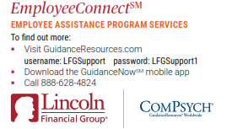
Employee Assistance Program – EAP
EmployeeConnect offers professional, confidential services to help you, and your loved ones improve your quality of life.
Receive confidential help 24 hours a day, seven days a week for employees and their family members. Get help with:
Family
Parenting
Addictions
Emotional
Legal
Financial
Relationships
Stress
Notes:
Employee Connect offers professional, confidential services to help you and your loved ones improve your quality of life for anyone with Lincoln coverage.
Receive confidential help 24 hours a day, seven days a week for employees and their family members.
Get help with:
-family
-parenting
-addictions
-emotional help
-legal
-financial troubles
-relationships
And stress
For more information about the program, please visit guidanceresources.com, download the guidance now mobile app, or call 888-628-4824

Slide 40
2025 Enrollment Process
Notes:
Let’s review the 2024 open enrollment process

Slide 41
2025 Enrollment Process For anyone new or making changes Log at www.employeenavigator.com
Click on the “Login” button to get started.
If you have already registered & have your username & password, enter them to log in.
If you forgot your password, you could request to reset it.
If this is your first time, you can find an invite email sent for new hires or select “Register as a New User”
Your first name and last name must match your employee file.
The company identifier is Vinylmax
PIN is the last 4 digits of your social security number
Enter your birth date in mm/dd/yyyy format
Click Next to register
Notes:
2024 Enrollment Process For anyone new or making changes Log at www.employeenavigator.com
Click on the “Login” button to get started.
If you have already registered & have your username & password, enter them to log in.
If you forgot your password, you can request to reset it.
If this is your first time, you can find an invite email sent for new hires or select “Register as a New User”
Your first name and last name must match your employee file.
The company identifier is Vinylmax
PIN is the last 4 digits of your social security number
Enter your birth date in mm/dd/yyyy format
Click Next to register

Slide 42
Mid-Year Plan Changes
You are only able to add or drop coverage during the plan year if you have a federal qualified event such as:
Change in marital status
Change in number of dependents
Change in employment status
Change in eligibility status
Any changes made must be consistent and correspond with the change in status.
Documentation is required for any mid-year status changes.
If you are making a mid-year plan change you must notify HR within 30 days of the qualifying event.
Notes:
You are only able to add or drop coverage during the plan year if you have a federal qualified event such as:
Change in marital status
Change in number of dependents
Change in employment status
Change in eligibility status
Any changes made must be consistent and correspond with the change in status.
Documentation is required for any mid-year status changes.
If you are making a mid-year plan change you must notify HR within 30 days of the qualifying event.

Slide 43
Benefit Resource Center
Notes:
If you have any questions on your benefits, feel free to reach out to our benefits resource center by email at brcmidwest@usi.com or call them at 1-855-874-0829. They are available Monday through Friday 8:00 am to 5:00 pm.

Slide 44
Thank You!
All open enrollment election changes are due by: Nov 15th , 2024
Notes:
Thank you for listening to this this presentation, make sure your elections are submitted by November 28th. Thank you.

