Slide 1
CONFIDENTIAL AND PROPRIETARY: This presentation and the information contained herein is confidential and proprietary information of USI Insurance Services, LLC ("USI"). Recipient agrees not to copy, reproduce or distribute this document, in whole or in part, without the prior written consent of USI. Estimates are illustrative given data limitation, may not be cumulative and are subject to change based on carrier underwriting. © 2018 USI Insurance Services. All rights reserved.

Slide 2
2024 Benefit Highlights
Our PPO & HSA medical plans are remaining with United Healthcare with no plan changes with only a 5% premium increase from 2023 to 2024
All UHC members have access to the UHC Rewards Wellness Program. Earn up to $300 in gift cards for completing wellness activities during 2024.
Lincoln dental renewed our plan with only at 5% premium increase.
EyeMed renewed our vision plan with a 0% premium increase.
Ancillary coverages – Life/AD&D, Voluntary Life/AD&D, Dental, Short-Term Disability and Long-Term Disability are staying with Lincoln Financial; no changes from 2023.
FSA remains with Navia; no changes from 2023.
HSA remains with PNC; no changes from 2023.
Notes:
Read Slide

Slide 3
2024 Benefit Highlights
New for 2024, we might be introducing a MEC Plan offering low-cost access to healthcare. MEC stands for Minimum Essential Coverage or “skinny plan”. This new product is not a major medical plan but offers affordable coverage for everyday services and prescriptions.
Since this MEC Plan is a new offering for 2024, we need first to determine total number of interested individuals to gauge if feasible to secure the offering of this plan.
Notes:
Read Slide

Slide 4
Key Information
Our 2024 Benefit Open Enrollment Period is
November 6th – November 28th
For open enrollment changes, log into OnBoardMyBenefits.
All benefit elections and changes will take effect January 1st, 2024. Payroll deductions will begin January 2024
Note for Open Enrollment: For employees electing to stay with current UHC enrollment it will be a passive open enrollment meaning you do not need to do anything, and your 2023 elections will automatically roll over for 2024 open enrollment, if do not wish to make changes. For open enrollment changes, log into OnBoardMyBenefits.
If you do not log into the Benefits Navigator during open enrollment to make changes, your 2023 elections will roll over automatically to 2024.
Anyone that would like to enroll in the MEC plan please see HR for the application to enroll. To enroll you must fill out a paper form. Since this is a new offering for 2024, we need first to determine total number of interested individuals to gauge if feasible to secure the offering of this plan.
Notes:
Read Slide

Slide 5
Open Enrollment
Per IRS rules:
This is your opportunity to make changes to your benefit elections and to review which dependents you will cover.
Elections made during this period will remain in effect for 2024, unless you experience an IRS-approved “qualifying event”
Approved qualifying events include:
Marriage or Divorce
Death
Birth or adoption of a dependent
Change in employment status
Change in dependent’s eligibility status
Loss of or significant change to your current coverage
Judgment, decree or court order
Elections will remain effective for all of 2024. You have 30 days from the date of the qualifying event to notify HR and make changes.
Notes:
Read Slide

Slide 6
Who is Eligible?
Full-Time employee working at least 30 hours per week
Spouses
Court Decree Spouse
Dependents:
Unmarried & married child(ren) to age 26
Full-Time Student to age 26
Court Decree Dependent

Slide 7
UHC Medical/Rx

Slide 8
UHC Medical Highlights
 | HDHP HSA | PPO
Annual Deductible | $5,000 per individual $10,000 per family | $4,000 per individual $8,000 per family
Annual Out-of-Pocket Maximum** | $6,750 per individual $13,500 per family | $7,900 per individual $15,800 per family
Plan Coinsurance | 80% in most cases | 70% in most cases
Primary Office Visit | DN: Deductible then 80% N: Deductible then 60% | $40 copay
Specialty Office Visit | DN: Deductible then 80% N: Deductible then 60% | DN: $60 copay / N: $100 copay
Lab & X-ray | Deductible then 80% | DN: Deductible then 70% N: Deductible then 50%
Complex Radiology | Deductible then 80% | 70% after deductible
Inpatient Hospital | Deductible then 80% | 70% after deductible
Emergency Room | Deductible then 80% | $300 copay then 70% after deductible
*The deductible is calculated on an embedded basis.
**The out-of-pocket maximum includes the deductible all eligible copays and coinsurance amounts.

Slide 9
Medical – HDHP HSA Features
Continuing for 2024 for the HDHP HSA Plan:
Vinylmax HSA contribution of $600 for an employee covered on the HDHP HSA plan and $1,000 for those with employee/spouse, employee/child, or family coverage.
Annual contributions are evenly distributed based on the employee’s pay frequency.
HSA contributions can be set-up on payroll and will automatically be set up through PNC Bank.
NOTE: Please refer to your vendor benefit summaries for a detailed listing of covered benefits. Benefits listed in this presentation are for illustrative purposes only.

Slide 10
UHC Rx – Plan Highlights
 | HDHP HSA | PPO
Rx Deductible | Rx subject to medical deductible | N/A
Retail Prescription Drugs
Generic | Deductible then $10 copay | $10 copay
Preferred Brand Name | Deductible then $35 copay | $65 copay
Non-Preferred Brand Name | Deductible then $60 copay | $125 copay
Preferred Specialty | Deductible then $250 copay | $250 copay
Mail-Order Prescriptions
Mandatory for Maintenance Rx? | No | N/A
Generic | Deductible then $25 copay | $25 copay
Preferred Brand Name | Deductible then $87.50 copay | $162.50 copay
Non-Preferred Brand Name | Deductible then $150 copay | $312.50 copay
Preferred Specialty | Deductible then $625 | $625 copay

Slide 11
What medical plan do I choose?
PPO Plan: Traditional Preferred Provider Organization Plan.
Compared to an HSA plan, this one has higher paycheck cost, lower deductible, higher out of pocket max.
Copayments (with no deductible) apply to office visits, prescriptions
All copayments apply to the out-of-pocket max.
This plan is good for those with steady, predictable medical expenses with lower out of pocket immediate risk exposure. (You're willing to pay higher premiums than the HSA in exchange for the certainty of lower out-of-pocket costs related to specific medical needs.)

Slide 12
What medical plan do I choose?
HDHP HSA Plan (High deductible Plan)
Compared to a PPO plan, this plan has a lower paycheck cost, higher deductible, lower out of pocket max.
Must pay the entire services and meet the deductible before insurance coverage begins (excluding preventive visits).
Can establish a health savings account (HSA) to cover current & future health expenses.
This plan is good for those who want to pay less with each paycheck and want the company contribution to the HSA but has readily available funds to pay for all health care costs before the deductible is met.

Slide 13
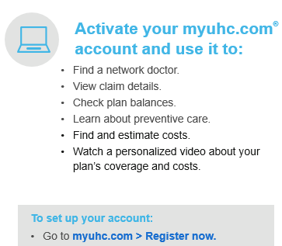
UHC Medical – Highlights
Preventive care– covered at 100% on all UHC medical plan options
Stay in network – sing in to myuhc.com > Find Care and Costs
UHC virtual visits – for nonemergency issues at myuhc.com/virtual visits

Slide 14
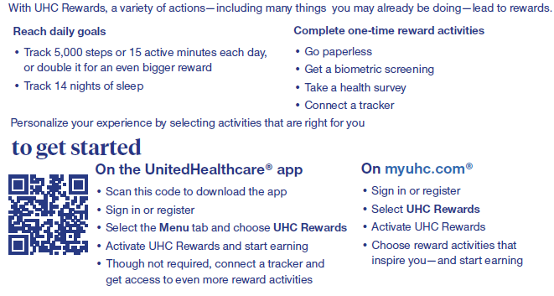
Wellness – UHC Rewards up to $300
Available to employees & spouses enrolled in a UHC plan

Slide 15
APEX MEC Medical/Rx

Slide 16
What medical plan do I choose?
MEC - Minimum Essential Coverage or “skinny plan”
This is not traditional health insurance. This is separate from UHC plans. Network is with PHCS.
Less expensive weekly premiums but limited protection & is not for everyone.
This plan doesn’t provide coverage for the emergency room, surgeries, or inpatient hospital.
This plan provides coverage at 100% for preventive services
Telehealth & behavioral services are free and unlimited.
Provides 3 primary care visits for $20 per visit. Additional visits charges, your responsibility.
Provides 3 specialty doctor visits for $50 per visit. Additional visits charges, your responsibility.
Provides 3 urgent care visits for $50 per visit. Additional visits charges, your responsibility.
Provides 5 visits to lab/x-ray for $50 per visit. Additional visits charges, your responsibility.
Provides 1 imagining for $200. Additional visits charges, your responsibility.
For more details, including prescription coverages, see plan summary.

Slide 17
What plan do I choose?
MEC - Minimum Essential Coverage or “skinny plan”
Keep in mind this is not a Major Medical plan, nor priced like a Major Medical plans.
Not intended for people with chronic conditions, or those in need of expensive specialty or maintenance drugs.
Pharmacies included in the network include Costco, CVS, Kroger, Meijer, Rite Aid, Sam’s, Walgreens, Walmart.
Here below, list of partner vendors:

Slide 18
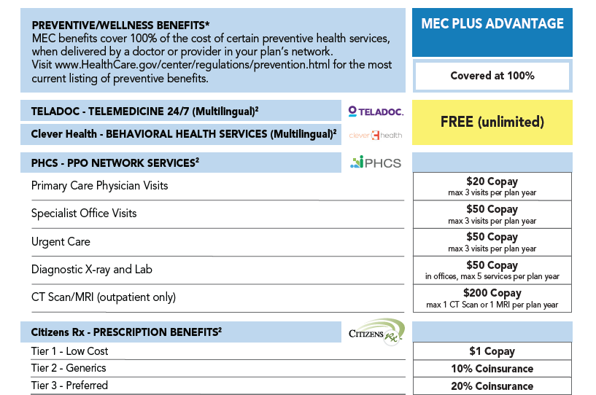
APEX MEC Medical – Highlights

Slide 19
Medical – Weekly Employee Contributions
Tier/Plan | Preferred Provider Organization PPO Plan |  | High Deductible Health Plan HDHP HSA Plan |  | MEC
Coverrage | Non-Tobacco User | Tobacco User | Non-Tobacco User | Tobacco User | Non-Tobacco User | Tobacco User
Employee | $59.05 | $69.05 | $54.43 | $64.43 | $10.96 | $20.96
Employee & Spouse | $129.79 | $139.79 | $119.64 | $129.63 | $22.15 | $32.15
Employee & Child(ren) | $99.68 | $109.68 | $91.88 | $101.87 | $22.15 | $42.15
Family | $182.29 | $192.29 | $168.02 | $178.02 | $32.77 | $42.77
Payroll deductions are on a weekly pre-tax basis*
Employee contributions shown above, Vinylmax is covering 60% of the cost.
Note: There is a $20/week spousal surcharge .
Notes:
Read summary and add…. Keep in mind the MEC Plus and MEC Plus Advantage are not Major Medical plans, nor are they priced like Major Medical plans. They are not intended for people with chronic conditions, or those in need of expensive specialty or maintenance drugs. pharmacies included in the network include Costco, CVS, Kroger, Meijer, Rite Aid, Sam’s, Walgreens, Walmart, as well as others. are in the network.

Slide 20
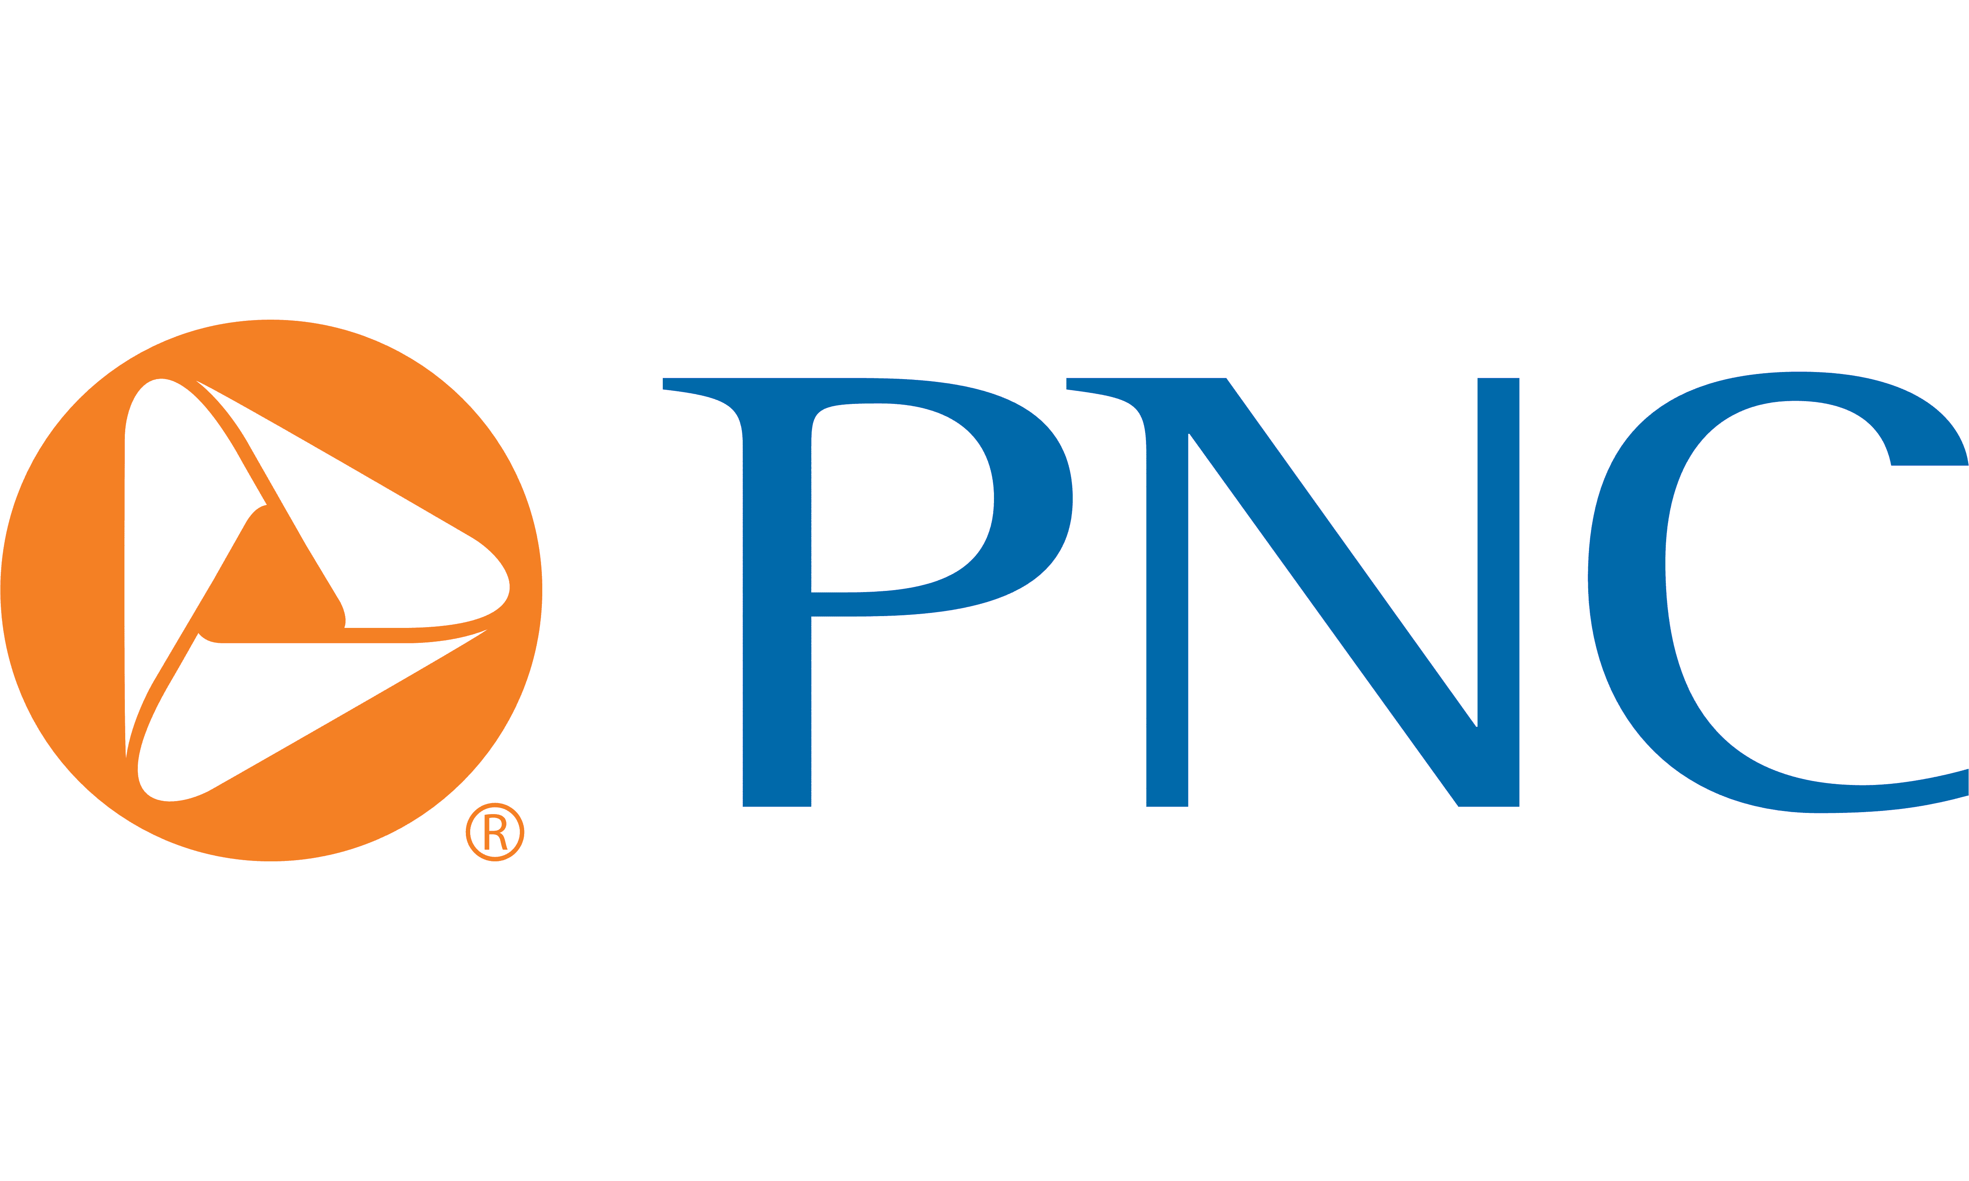
Health Saving Spending Account

Slide 21
Health Savings Account
A Health Savings Account (HSA) is a type of account you can use to set aside money to pay for qualified health care expenses.
This account helps offset your medical costs by giving you tax advantages, allowing your income to stretch farther by using the dollars that would have otherwise been paid in taxes.
You must be eligible for an HSA
You may only spend the dollars on qualified medical expenses and keep itemized receipts
The IRS sets an annual maximum contribution each year. For 2023 the maximum contribution is:
$4,150 for Individuals
$8,300 for Family
Those 55 and older and not enrolled in Medicare can contribute an additional $1,000 “catch up” contribution
Vinylmax Annual HSA Enrollment Contribution | Amount
Employee | $600
Employee & Spouse | $1,000
Employee &Child(ren) | $1,000
Family | $1,000
Notes:
Read slide

Slide 22
Health Savings Account
All HSA accounts are managed by PNC Bank.
If you currently have an HSA through another bank, you will have to fill out a Direct Transfer Request Form from PNC to request your previous trustee/custodian to transfer all assets from another HSA into your PNC BeneFit Plus Account.
Notes:
Read slide

Slide 23
Flexible Spending Account

Slide 24
Flexible Spending Accounts
Flexible Spending Accounts (FSA) are a great way for you to SAVE MONEY on pre-planned health and day care expenses!
Participation is 100% voluntary
Savings are TAX FREE, not Tax Deferred
Supported by Section 125 and 129 of the IRS Code
2024 Contribution Maximum: $3,200
Decision is IRREVOCABLE for the entire plan year!
Adjustments can be made if a “permitted election change events” (marriage, divorce, death, birth, adoption) occurs
Watch out for the “Use it or Lose it” rule

Slide 25
Dependent Care FSA Plan
Dependent care FSA annual max is $5,000. Plan features include:
Payment for certain IRS-approved dependent daycare expenses with pre-tax dollars.
Rollover provision does not apply. Use it or lose it rule applies.
Eligible for care while parents are at work or school.
ONLY amount payroll deducted to date is available for distribution.
Some examples include:
Daycare/Preschool for dependent children
Adult daycare
Before and after school programs
Camps

Slide 26
Dental
Notes:
Let’s review your dental offering

Slide 27
Dental - Highlights
 | Dental PPO
Annual Deductible | $50 per individual $150 per family
Benefit Maximum | $1,500
Deductible Waived for Preventive Care | Yes
Preventive Care | 100%
Basic Services* | 80% after deductible
Major Services* | 50% after deductible
Orthodontia Services | 50% with a lifetime max of $1,500
 | Weekly Contributions
Employee | $3.01
Family | $7.39
Employee Contributions shown, Vinylmax is covering 50% of the cost.
Notes:
Next, we’ll look at the vision offering.

Slide 28
Vision
Notes:
Next, we’ll look at the vision offering.

Slide 29
Vision – Highlights
 | Vision Plan
Exam Copay | $10 copay
Material Copay | $25 copay
Benefits & Frequency
Exam | Covered every 12 months
Lenses | $25 copay every 12 months
Frames | $130 allowance, 20% of balance, every 24 months
Elective Contacts (in lieu of lenses) | $130 allowance, 15% of balance, every 12 months
 | Weekly Contributions
Employee | $1.49
Employee & Spouse | $2.83
Employee &Child(ren) | $2.98
Family | $4.38
Notes:
Next, we’ll look at the vision offering.

Slide 30
Ancillary Coverages
Notes:
Let’s review your ancillary coverages

Slide 31
Basic Life/AD&D
Vinylmax Windows is pleased to provide an employer paid life and accidental death & dismemberment (AD&D) benefit to all eligible employees:
Employee Benefit
$25,000 Life Insurance
$25,000 Guarantee Issue Amount
$25,000 is the Maximum Benefit Amount
Please be sure to review and update your beneficiary information as needed; does not have to be done during Open Enrollment.
Notes:
Vinylmax windows is pleased to provide an employer paid life and accident death and dismemberment also known as AD&D benefit to all eligible employees.
The life insurance amount is $25,000 with a guaranteed issue of $25,000
Please be sure to review and update your beneficiary information as needed. This does not have to be done during Open Enrollment

Slide 32
Voluntary Life AD&D Insurance
Voluntary Life Insurance Options
Employee: Increments of $10,000
Spouses: Increments of $5,000
Eligible Children: Flat amount $1,000, $2,000, $4,000, $5,000 or $10,000
Employee must be enrolled to elect coverage for spouse and/or child(ren)
EOI (Evidence of Insurability) form is required if:
You and/or spouse is requesting an amount more than the Guarantee Issue maximum
You and/or spouse is increasing the current level of coverage
You and/or spouse previously declined coverage and are electing coverage this year
Costs are listed in your Enrollment Guide
100% paid for by the employee

Slide 33
Disability Insurance
Disability insurance protects your paycheck if you are unable to work due to a qualifying disability (accident or sickness).
Simply put, a short-term disability is an instance that puts you out of work temporarily, such as an injury, illness or procedure. When one of these incidents happens and you cannot earn an income, you may be able to qualify for benefits if you are enrolled in a short-term disability insurance plan of time.
Long-term disability insurance provides income to those whose earnings are interrupted by lengthy periods of disability
Notes:
Read slide

Slide 34
Core Short Term Disability
The following highlights details regarding our employer paid short-term disability plan.
This plan is 100% covered by Vinlymax for Full-Time eligible employees. If you would like to purchase additional short-term disability coverage, there is a buy-up option on the next slide.
 | STD Core Plan
Elimination Period
Accident | 7 days
Sickness | 7 days
Benefit Percentage | 50%
Weekly Benefit Maximum | $170
Maximum Benefit Period | 13 weeks
Pre-Existing Condition Limitations | None
Notes:
Read slide

Slide 35
Voluntary Buy-Up Short Term Disability
The following highlights details regarding our employee paid short-term disability plan.
This plan is 100% paid for by the employee, if you would like to purchase additional short-term disability coverage.
 | STD Buy-up Plan
Elimination Period
Accident | 7 days
Sickness | 7 days
Benefit Percentage | 60%
Weekly Benefit Maximum | $500
Maximum Benefit Period | 13 weeks
Pre-Existing Condition Limitations | None
Notes:
Read slide

Slide 36
Long-Term Disability
The following highlights details regarding our long-term disability plan.
100% paid by employees if you wish to purchase long-term disability coverage
Offered to salaried employees at no cost
 | Long-Term Disability
Elimination Period | 90 days
LTD Benefit | 60% up to a monthly maximum of $5,000
Definition of Disability | 2-year own occupation
Maximum Disability Period | Social Security Normal Retirement Age
Pre-Existing Condition Limitations | 12 months for conditions treated within the 3 months prior to effective date of coverage
Notes:
Read slide

Slide 37
Voluntary Accident Insurance
Accident insurance is a form of insurance policy that offers a payout if you experience an injury outside of work.
You have a choice of two plans: Low Plan and High Plan.
Coverage is guaranteed for you and your family.
Payments are made directly to you to spend as you choose.
100% paid by employees, if you want to purchase voluntary accident insurance.

Slide 38
Voluntary Critical Illness
Critical Illness Insurance provides benefits when a covered person is diagnosed with an eligible condition or illness. It helps offset expenses not reimbursed by other types of insurance.
It is not a replacement for traditional medical or disability income insurance. Rather it is a compliment to these other coverages.
Your critical illness insurance enrollment is guaranteed provided you are actively at work.
100% paid by employees, if you want to purchase voluntary critical illness insurance

Slide 39
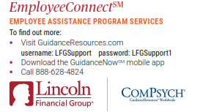
Employee Assistance Program – EAP
EmployeeConnect offers professional, confidential services to help you and your loved ones improve your quality of life.
Receive confidential help 24 hours a day, seven days a week for employees and their family members. Get help with:
Family
Parenting
Addictions
Emotional
Legal
Financial
Relationships
Stress
Notes:
Employee Connect offers professional, confidential services to help you and your loved ones improve your quality of life for anyone with Lincoln coverage.
Receive confidential help 24 hours a day, seven days a week for employees and their family members.
Get help with:
-family
-parenting
-addictions
-emotional help
-legal
-financial troubles
-relationships
And stress
For more information about the program, please visit guidanceresources.com, download the guidance now mobile app, or call 888-628-4824

Slide 40
2024 Enrollment Process
Notes:
Read slide

Slide 41
2024 Enrollment Process
This open enrollment is passive meaning your current enrollment selections will roll over to 2024. If you’d like to make any changes, you need to go online through Employee Navigator to make those selections/changes.
New ID cards will be sent home only if you are a new enrollee.
To enroll and/or learn more about the NEW MEC Advantage Plus option, please see HR for the application and details.
No benefit enrollments or changes are accepted after the open enrollment period unless due to a family status change (qualifying event).
Notes:
Read slide

Slide 42
2024 Enrollment Process For anyone new or making changes Log at www.employeenavigator.com
Click on the “Login” button to get started.
If you have already registered & have your username & password, enter them to log in.
If you forgot your password, you can request to reset it.
If this is your first time, you can find an invite email sent for new hires or select “Register as a New User”
Your first name and last name must match your employee file.
The company identifier is Vinylmax
PIN is the last 4 digits of your social security number
Enter your birth date in mm/dd/yyyy format
Click Next to register
Notes:
Read slide

Slide 43
Mid-Year Plan Changes
You are only able to add or drop coverage during the plan year if you have a federal qualified event such as:
Change in marital status
Change in number of dependents
Change in employment status
Change in eligibility status
Any changes made must be consistent and correspond with the change in status.
Documentation is required for any mid-year status changes.
If you are making a mid-year plan change you must notify HR within 30 days of the qualifying event.
Notes:
Read slide

Slide 44
Benefit Resource Center
Notes:
Read slide

Slide 45
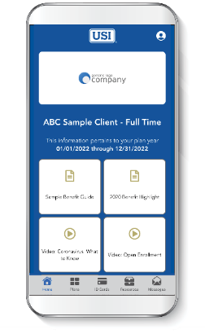
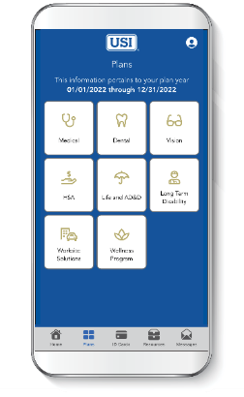
Benefits Mobile App
MyBenefits2GO provides on-the-go access to your benefit plan details, HR contact information and more!
MyBenefits2GO is a quick and simple way for you and your enrolled dependents to access benefit summaries and other important information about our group plans. Store photos of ID cards and easily locate carrier and HR contact information—all in one place. The app is free and available for iPhone and Android.
Stay Organized Store your benefit plan information and ID cards in one easy-to-find place.
Lighten Your Wallet Save a photo of your ID card for each plan so you always have it when you need it.
Get In Touch Find the contact information for carriers and HR all in one spot.
Access Codes:
Ohio – L92237
New York – G39497
Notes:
Read slide

Slide 46
Thank You
All open enrollment election changes are due by: Nov 28, 2023
Notes:
Read slide

